Slide 1
Null model correction with fdrtool
Aneuploidy project
Holly McQueary
Summer 2018

Slide 2
What the problem was
DESeq2 calculates a single variance for each gene across all samples
Samples that don’t have similar variances to the calculated variance will be thrown off
My data’s variance is all over the place, so several looked crazy.
To fix this, can use p-value correction
Two ways:
Fdrtool (the one I’ve used so far) http://strimmerlab.org/software/fdrtool/
Another R-based method found in this paper: https://www.degruyter.com/view/j/sagmb.2014.13.issue-6/sagmb-2013-0074/sagmb-2013-0074.xml
I haven’t tried this one yet, not sure if I should or just stay with fdrtool

Slide 3
What I did
Performed DESeq differential expression analysis on samples
Once including aneuploid chromosomes in the normalization procedure
Once excluding aneuploid chromosomes in the normalization procedure
Because: another paper (cite) took out the aneuploid chromosomes in their normalization so that the program didn’t normalize to them and throw a lot of things off
Created p-value histograms for each sample of:
Aneuploid chromosomes included, no correction
Aneuploid chromosomes included, correction
No aneuploid chromosomes included, no correction
No aneuploid chromosomes included, no correction

Slide 4
This slideshow...
In the following slides, I show each of the above histograms for each sample. I have marked in a red box which histogram (i.e. analysis method) I will use for that sample. Slides marked with a lime green lightning bolt are ones I am unsure of. I have provided a brief explanation of my choice of analysis in the notes section of each slide.
The #DE is the number of differentially expressed genes with a padj<0.1
My questions are:
Is it okay to do a different analysis procedure on different samples (i.e. fdrtool variance correction on one and not the other) ?
Do my choices of analysis method make sense?
What should I do about samples 2,3, 5, 6, and 9? These are all euploids.

Slide 5
My assumptions
The p-value histogram under the null model should be uniform
Samples with aneuploid chromosomes should have higher numbers of DE genes
Samples without aneuploid chromosomes should have lower numbers of DE genes

Slide 6
Resources about fdrtool, null model variance correction, etc
DESeq2 and hill-shaped p-value histograms: https://support.bioconductor.org/p/102313/
DESeq2 and fdrtool: https://support.bioconductor.org/p/94020/
DEseq2 and fdrtool: https://support.bioconductor.org/p/93333/
Right-skewed p value histograms: https://support.bioconductor.org/p/35556/
DESeq2 and hill-shaped p-value histograms: https://support.bioconductor.org/p/71438/#71476
Blog post on how to interpret a p-value histogram: http://varianceexplained.org/statistics/interpreting-pvalue-histogram/
Link to fdrtool on CRAN: https://cran.r-project.org/web/packages/fdrtool/index.html

Slide 7
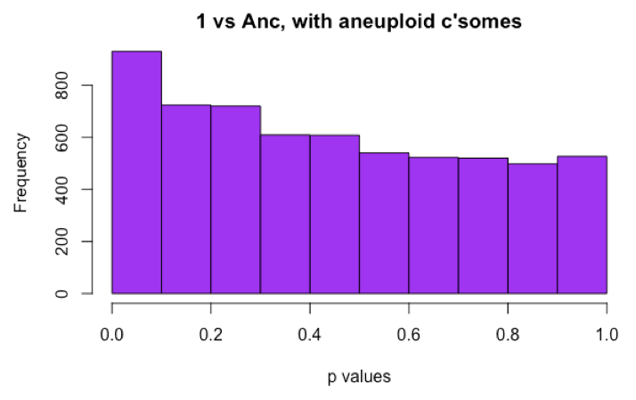
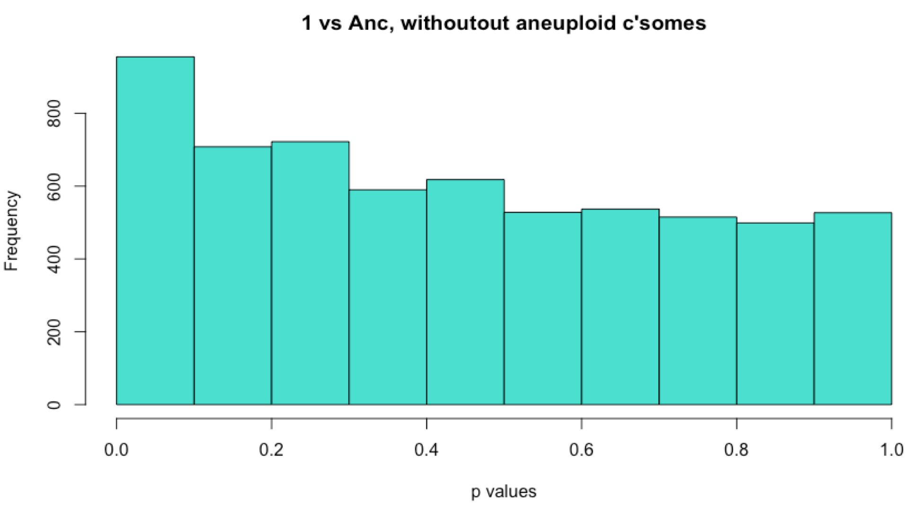
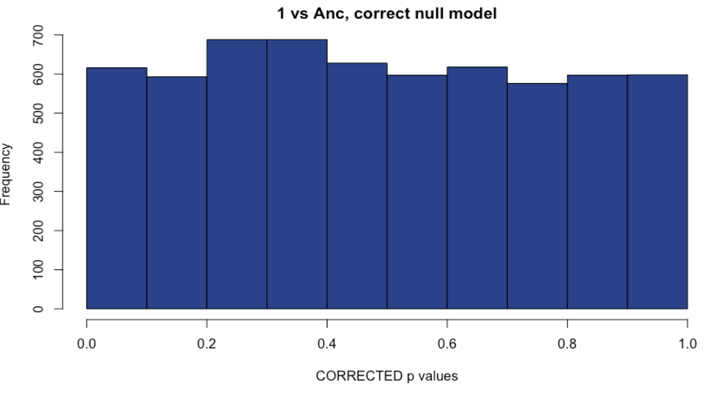
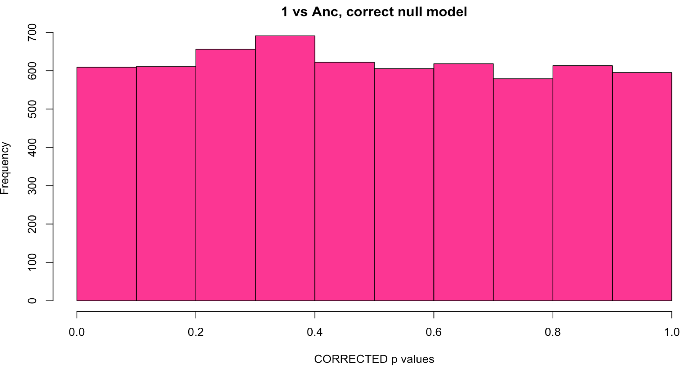
Sample 1: Comparison with methods
WITH Aneuploid C’somes WITHOUT Aneuploid c’somes
# DE: 23
# DE: 22
Uncorrected
Corrected with fdrtool
# DE: 0
# DE: 0
Notes:
For ALL OF THEM, I am choosing to exclude the aneuploid chromosomes from the normalization procedure because I believe they will be throwing off my data too much if I leave them in.
Sample 1, I chose uncorrected over corrected because I still obtained some differentially expressed genes, which is not the case for the corrected p values.

Slide 8
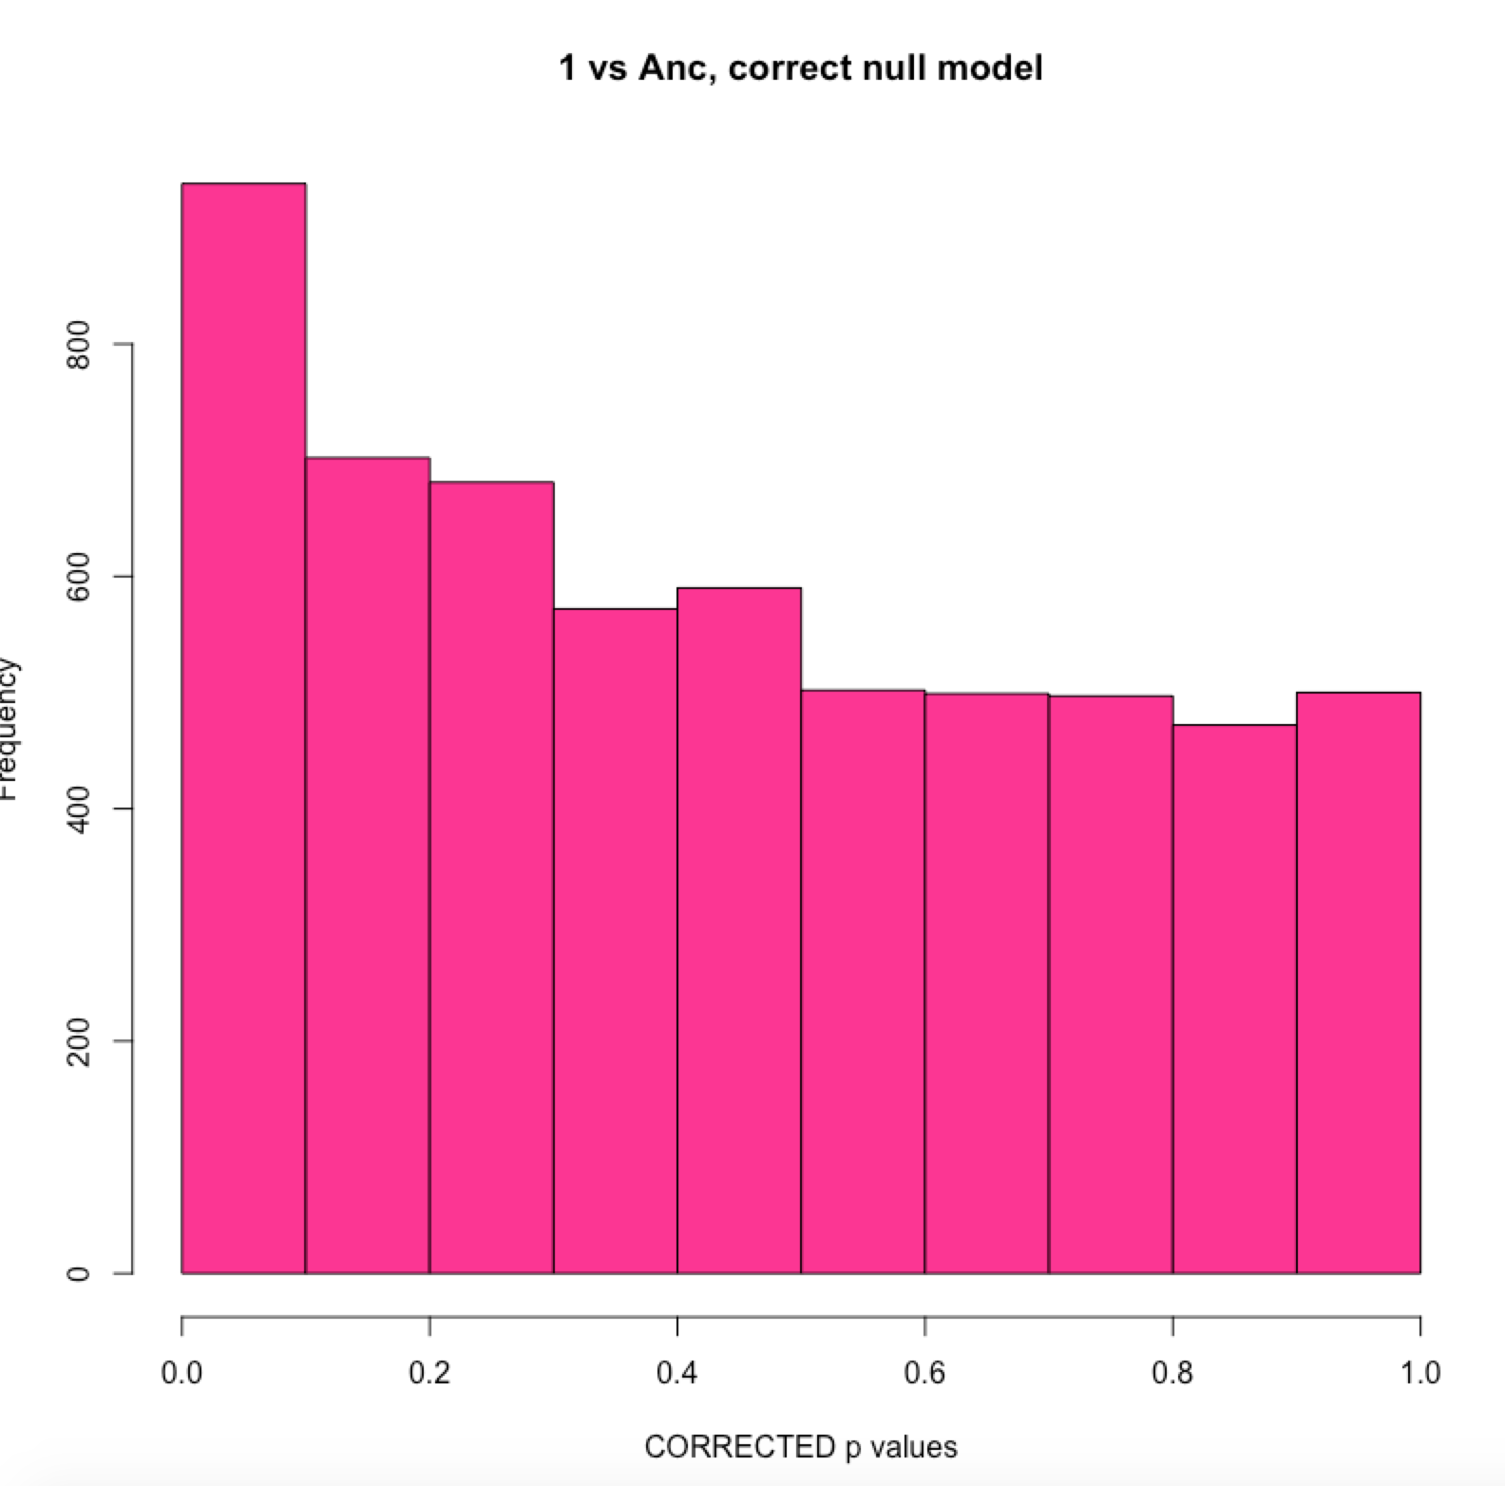
Sample 1: compare fdr tool parameters
Without aneuploid chromosomes in normalization
P-value used instead of test statistic
DE genes = 40

Slide 9
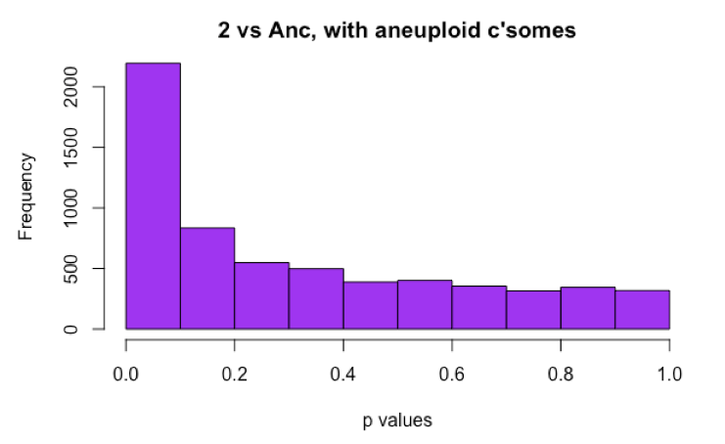
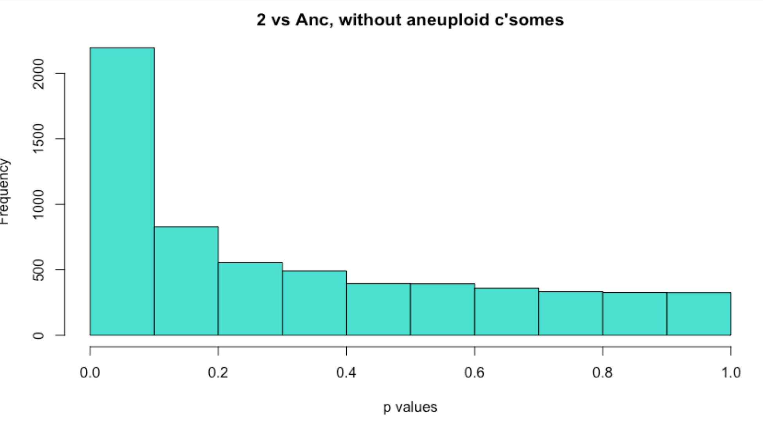
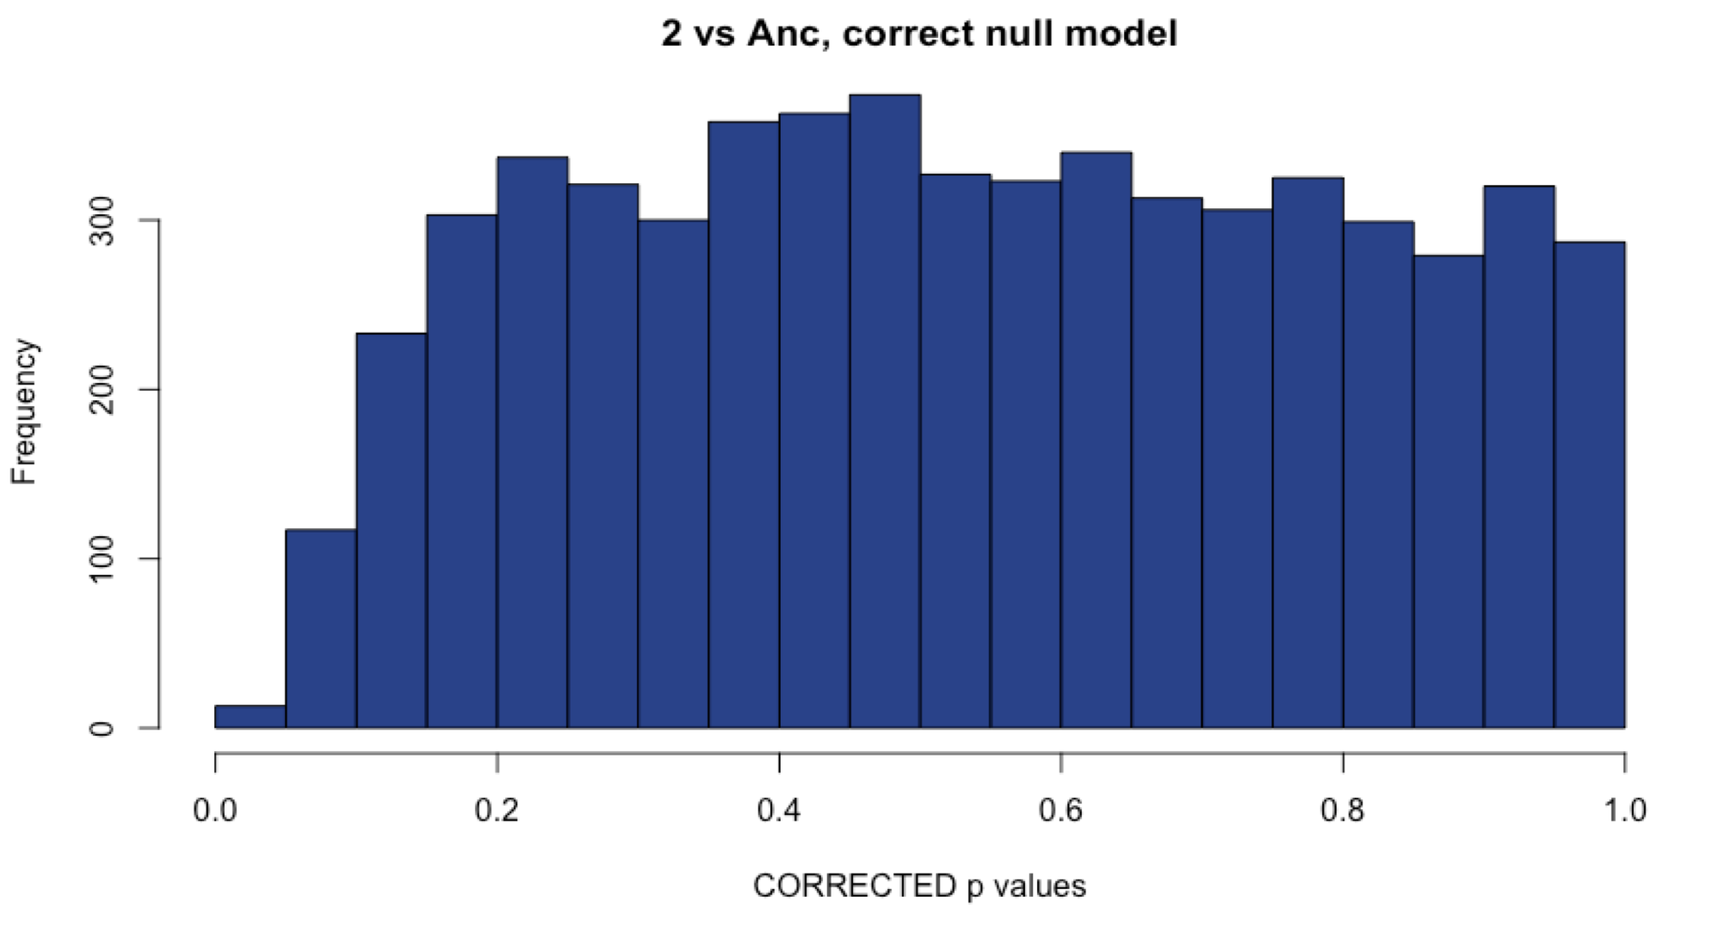
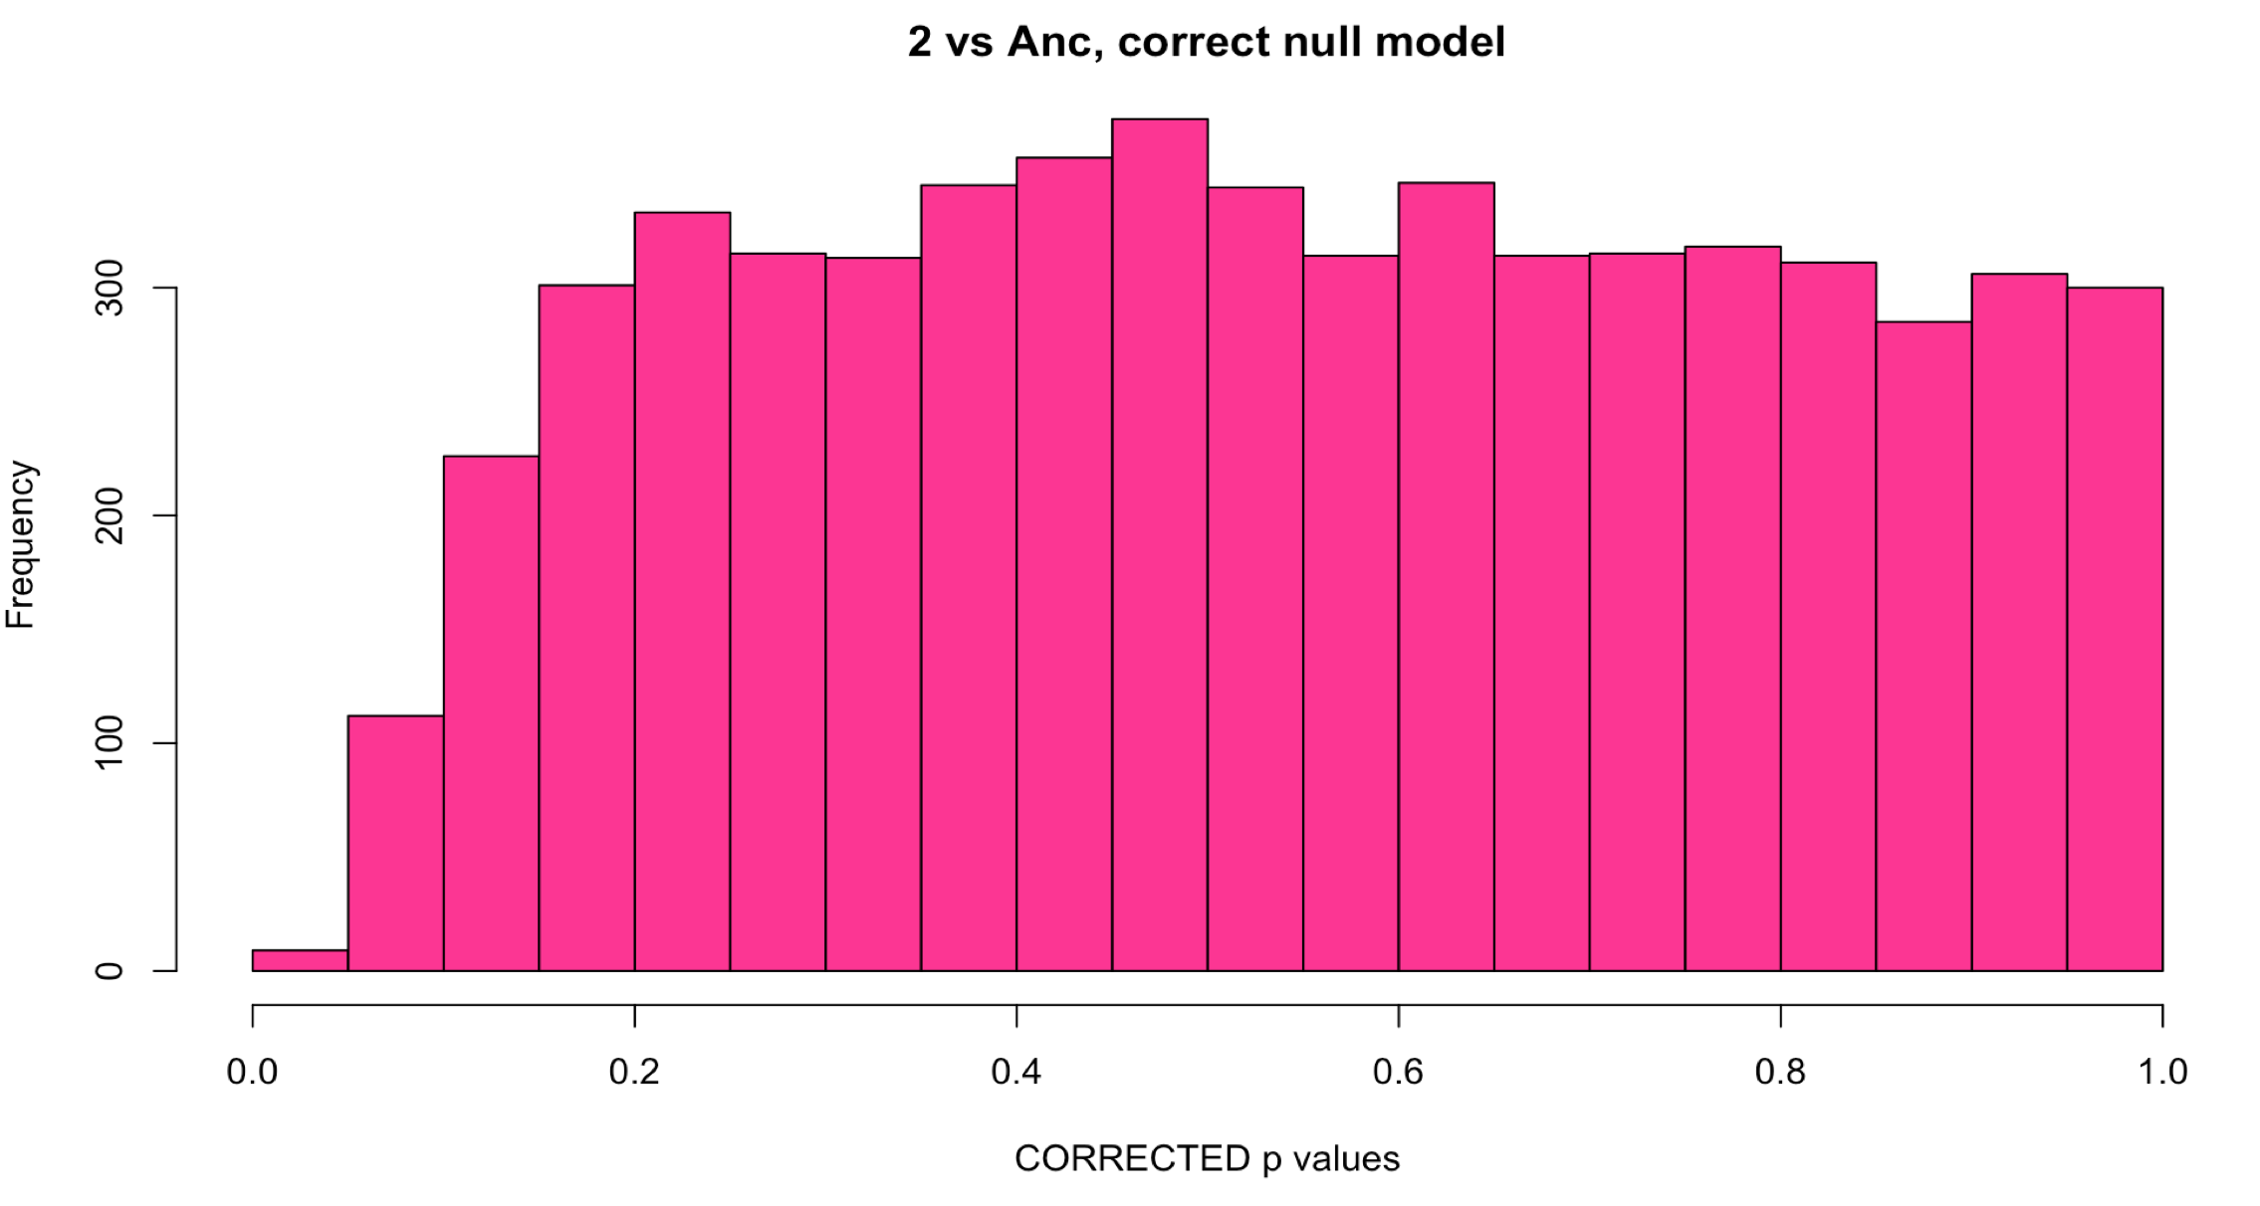
Sample 2: Comparison with methods
WITH Aneuploid C’somes WITHOUT Aneuploid c’somes
# DE: ~900
# DE: ~900
Uncorrected
Corrected with fdrtool
# DE: 0
# DE: 0
Notes:
I am unsure what to do with this sample. 900 DE genes sounds like a lot for a euploid line, but the correction reduces that number to 0.

Slide 10
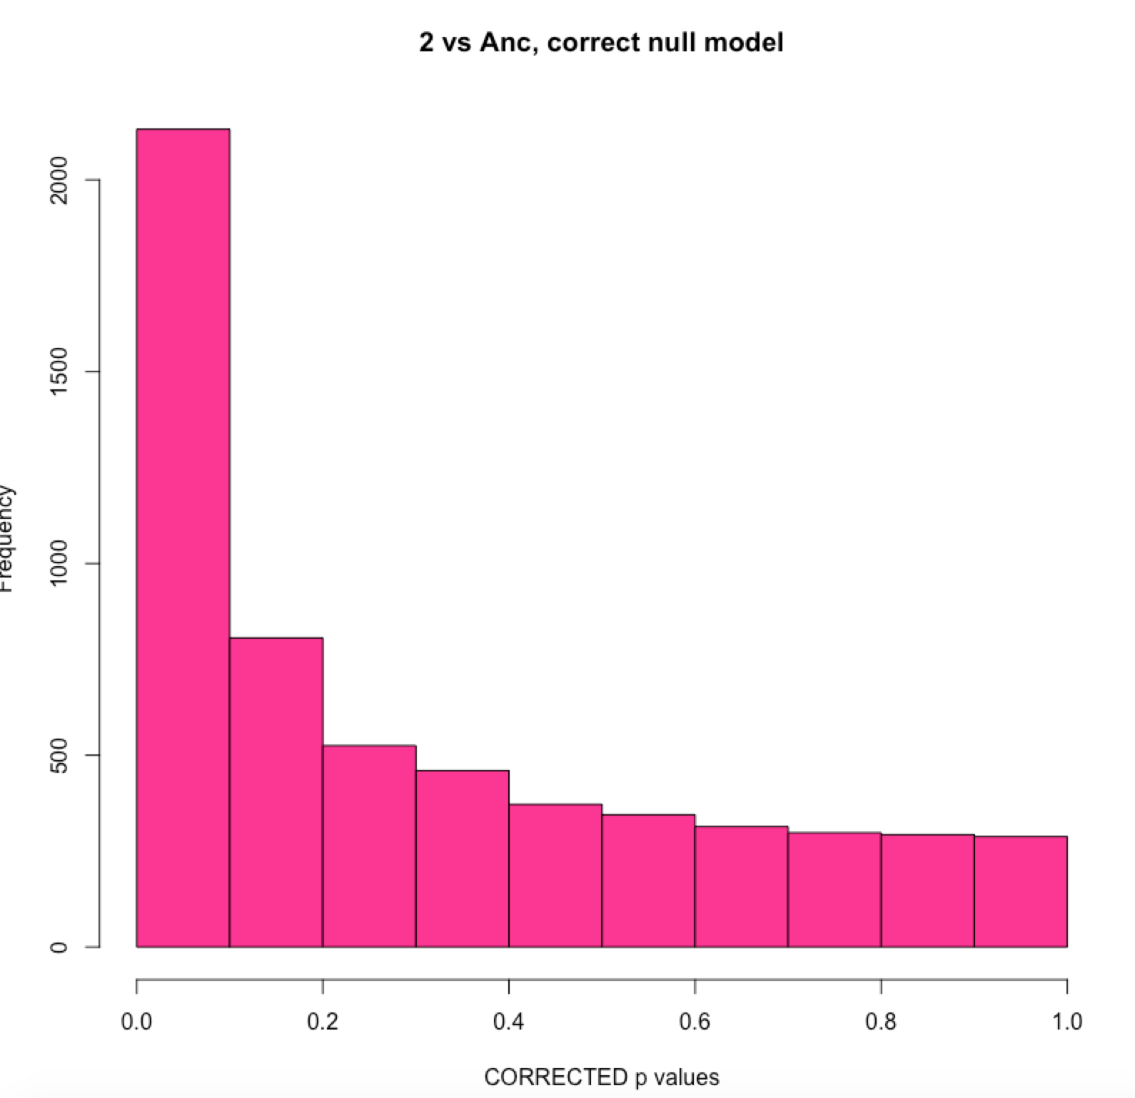
Sample 2: compare fdr tool parameters
Without aneuploid chromosomes in normalization
P-value used instead of test statistic
900 DE Genes

Slide 11
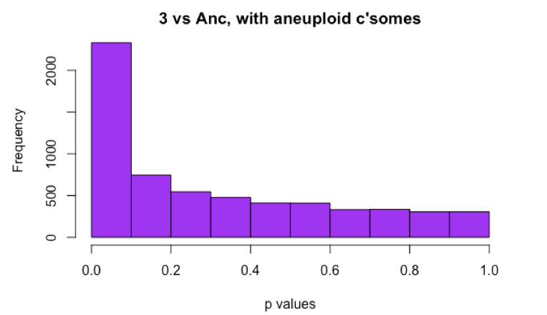
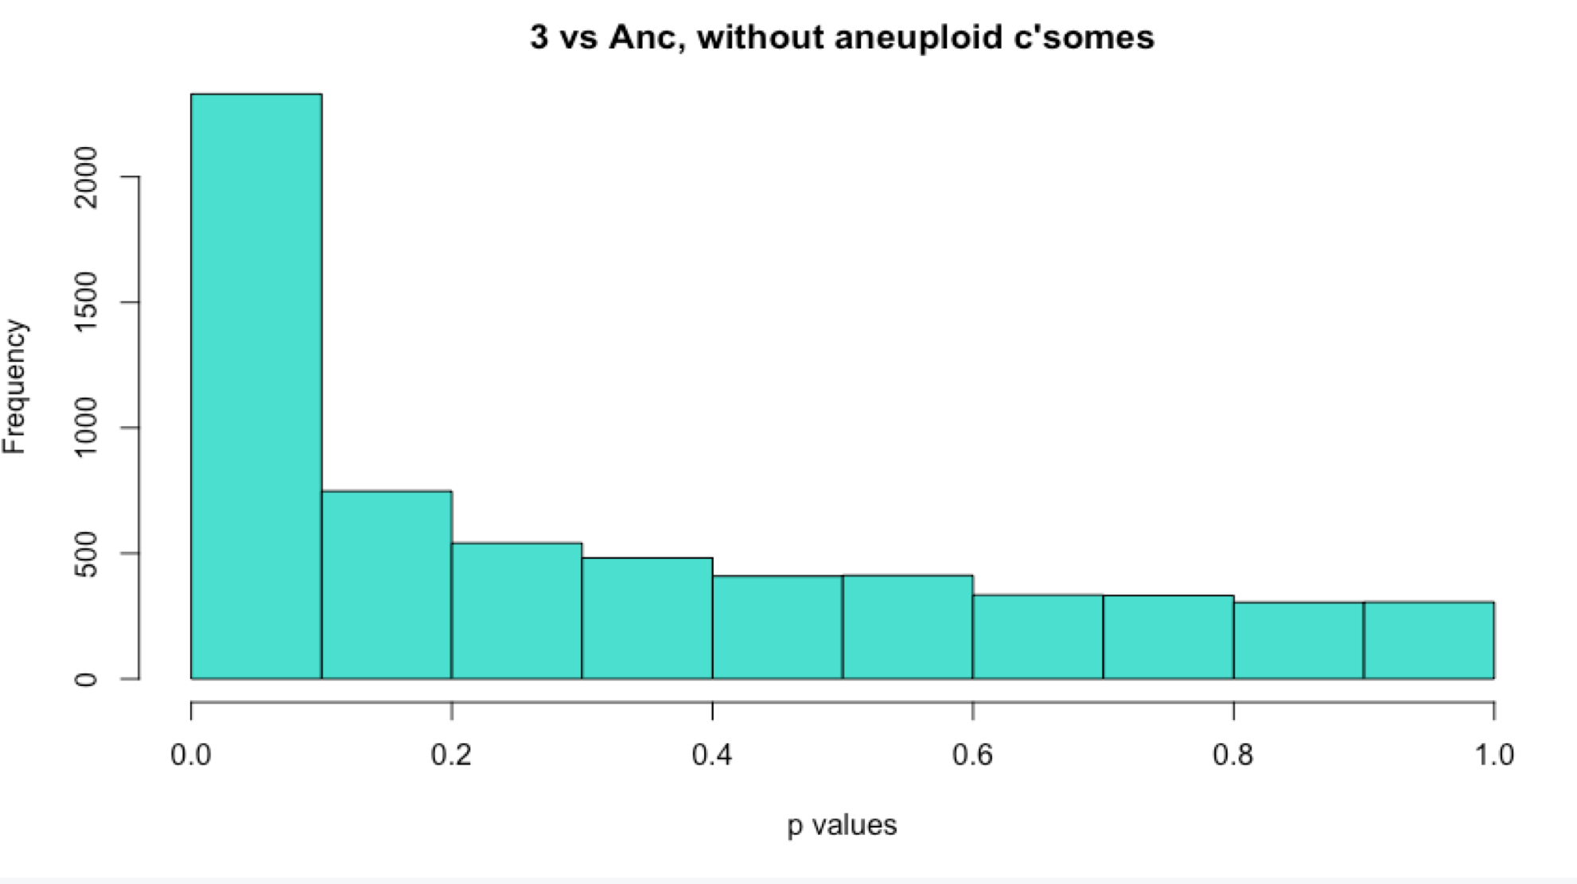
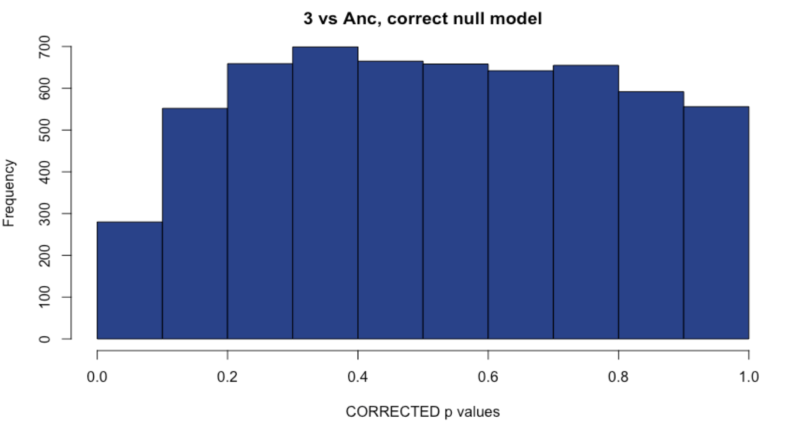
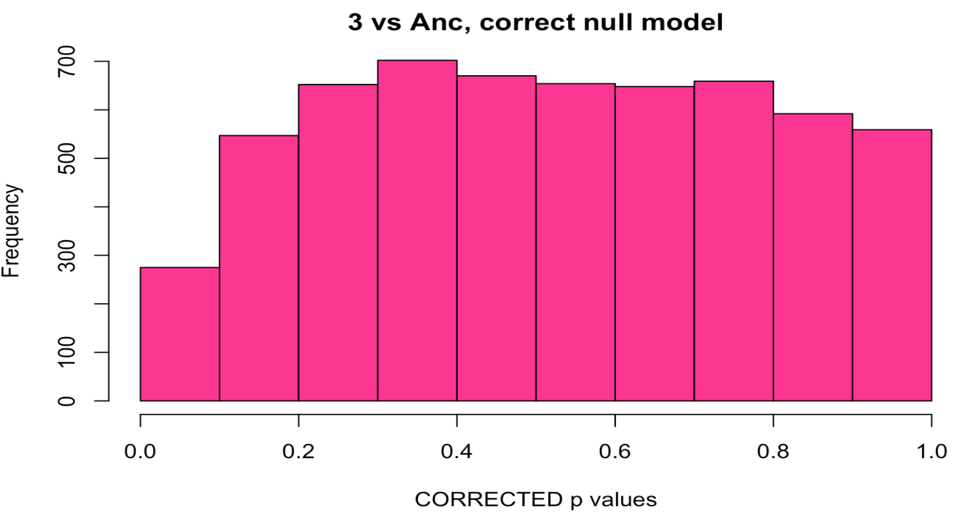
Sample 3: Comparison with methods
WITH Aneuploid C’somes WITHOUT Aneuploid c’somes
# DE: ~1000
# DE: ~1000
Uncorrected
Corrected with fdrtool
# DE: 0
# DE: 0
Notes:
Same as #2

Slide 12
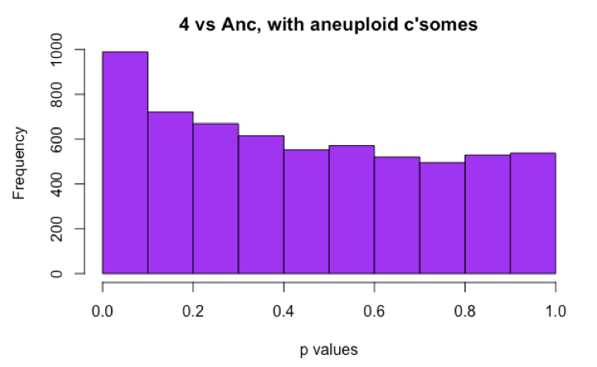
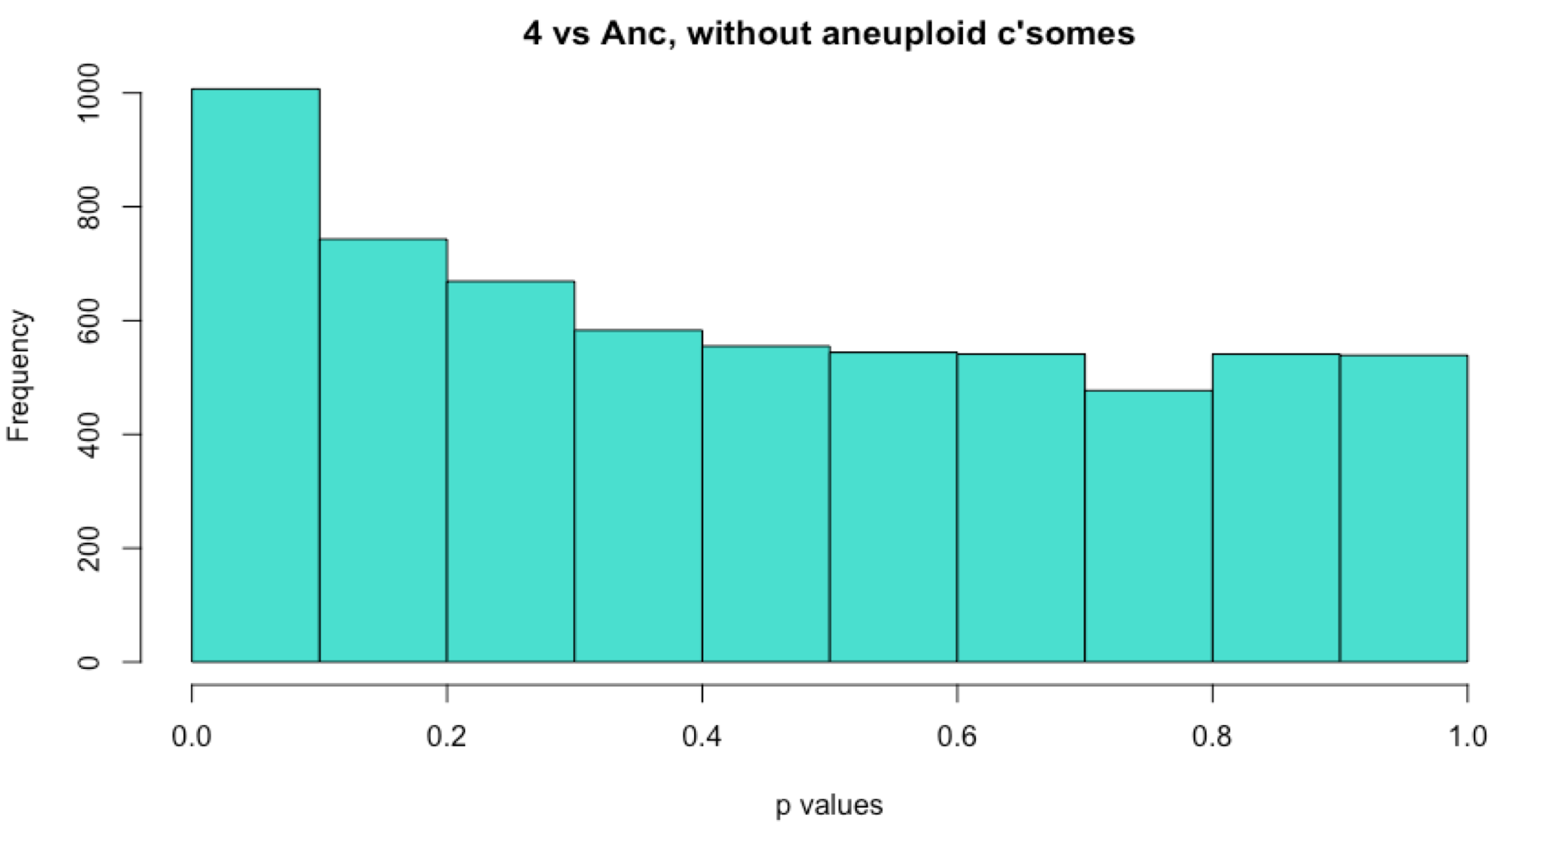
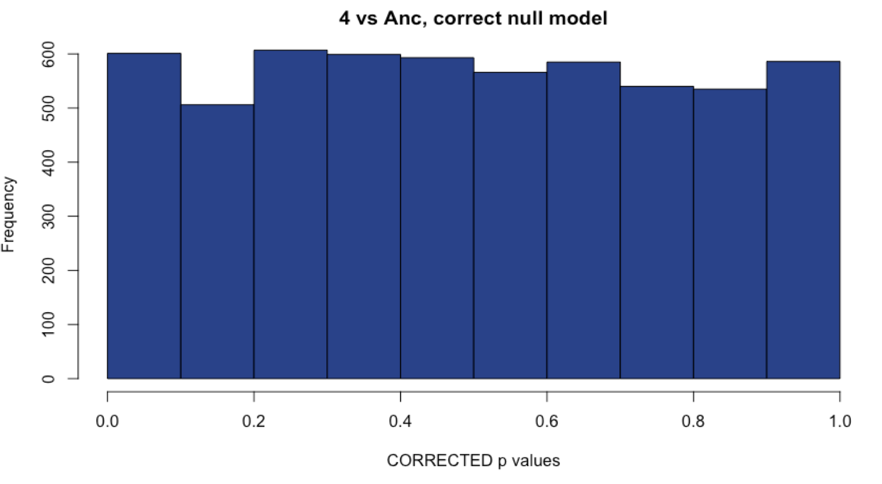
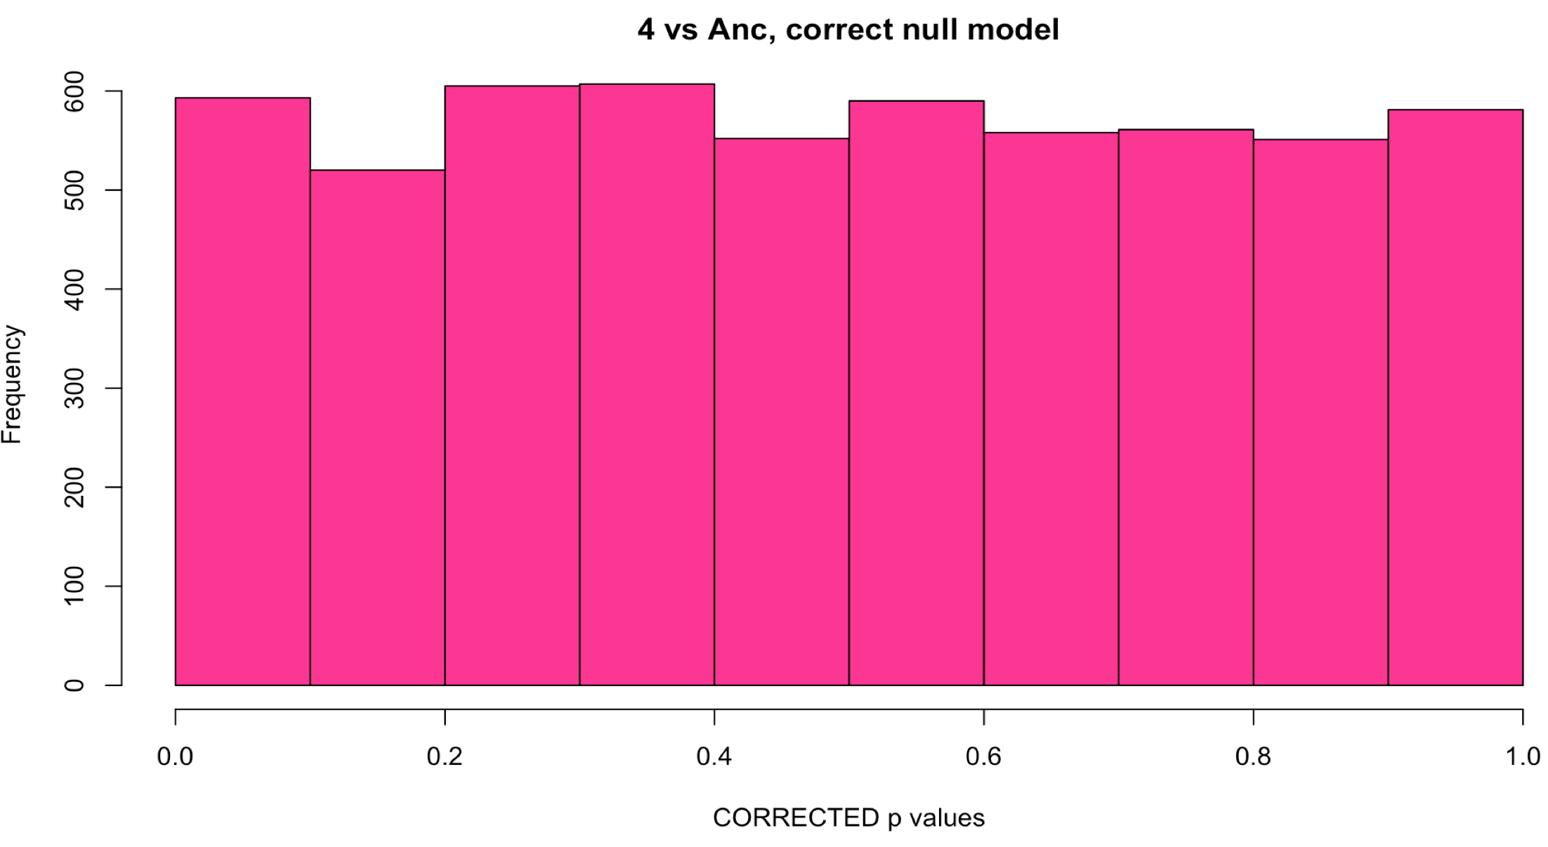
Sample 4: Comparison with methods
WITH Aneuploid C’somes WITHOUT Aneuploid c’somes
# DE: 98
# DE: 120
Uncorrected
Corrected with fdrtool
# DE: 35
# DE: 34
Notes:
Sample 4 is aneuploid, so I chose the method that gave me the most DE genes (and the histogram looks correct).

Slide 13
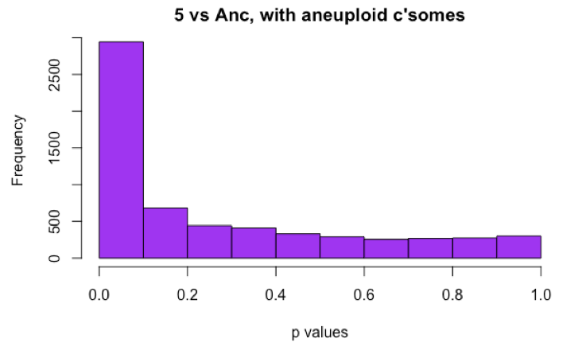
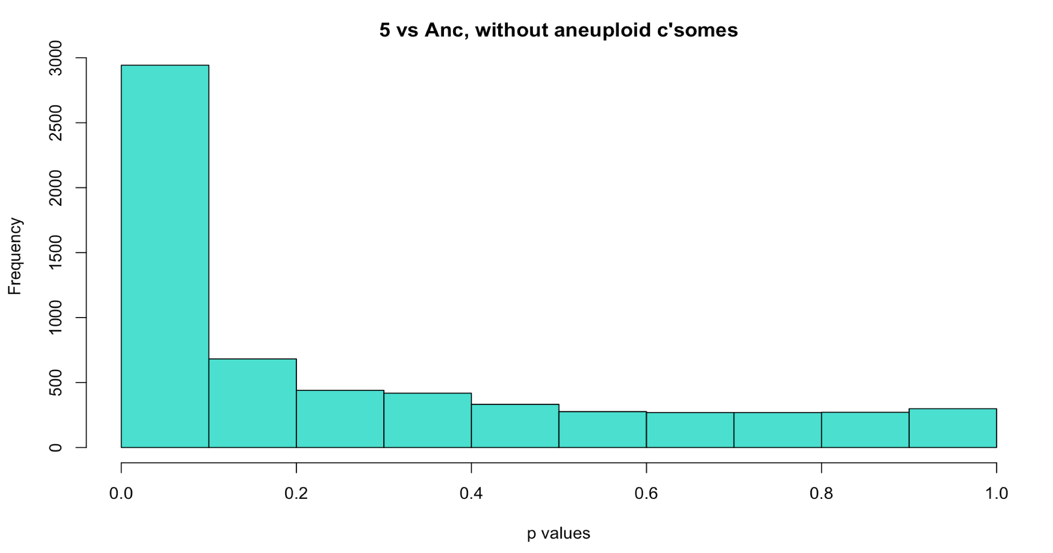
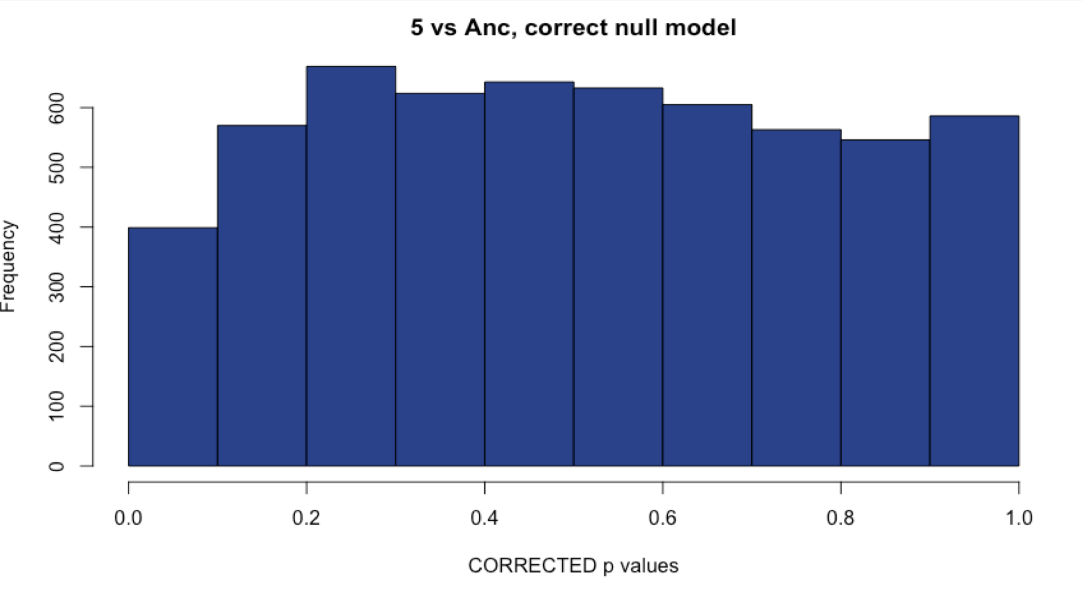
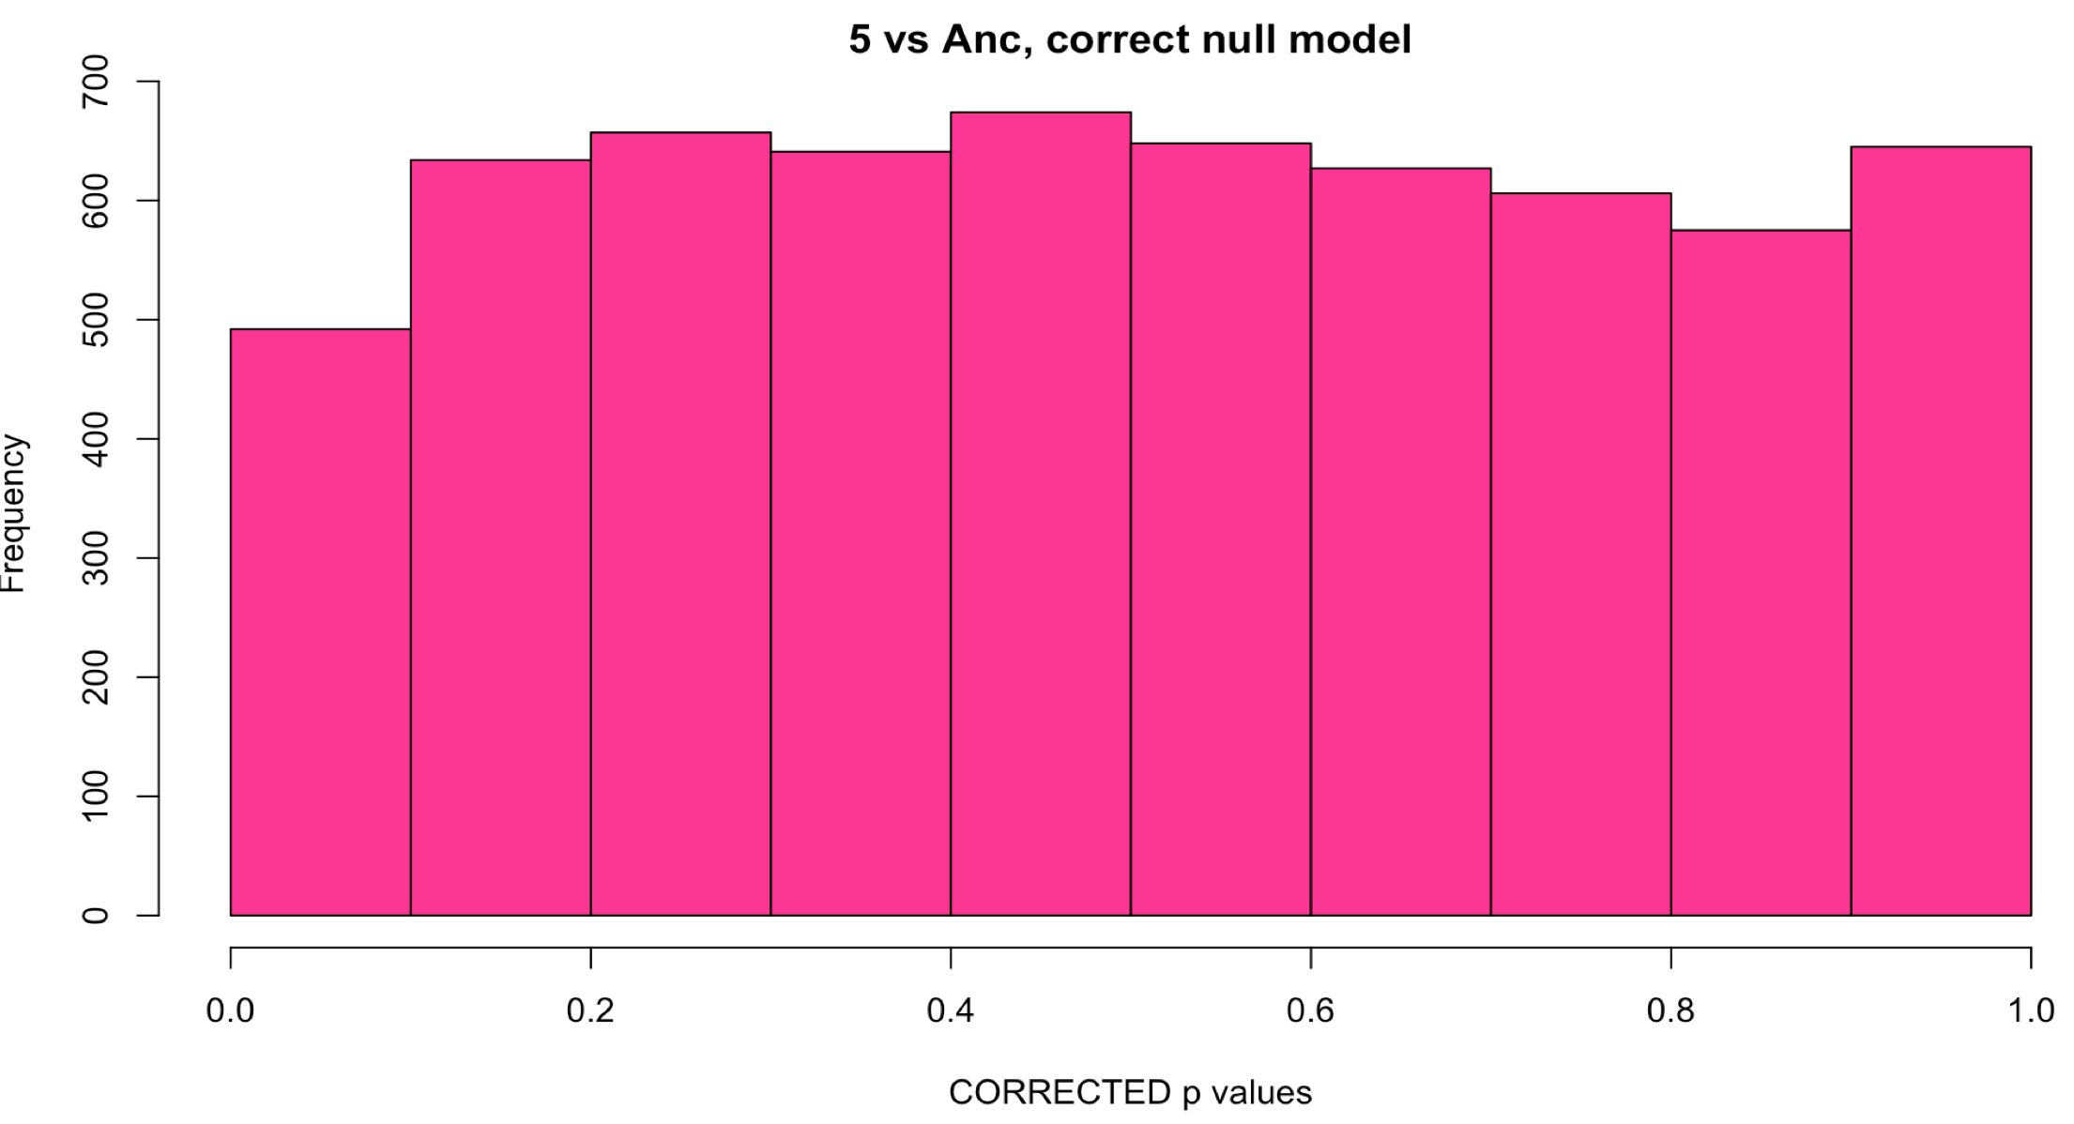
Sample 5: Comparison with methods
WITH Aneuploid C’somes WITHOUT Aneuploid c’somes
# DE: ~2200
# DE: ~2200
Uncorrected
Corrected with fdrtool
# DE: 0
# DE: 0
Notes:
Unsure of what to do here.

Slide 14
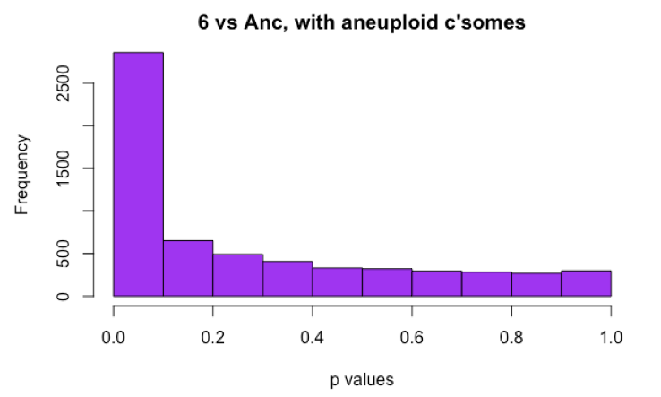
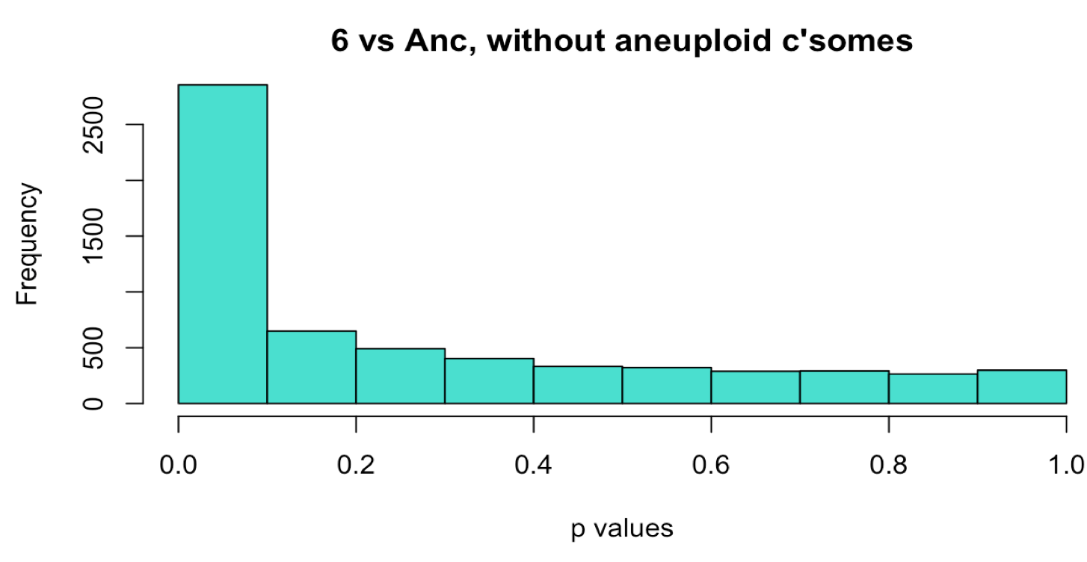
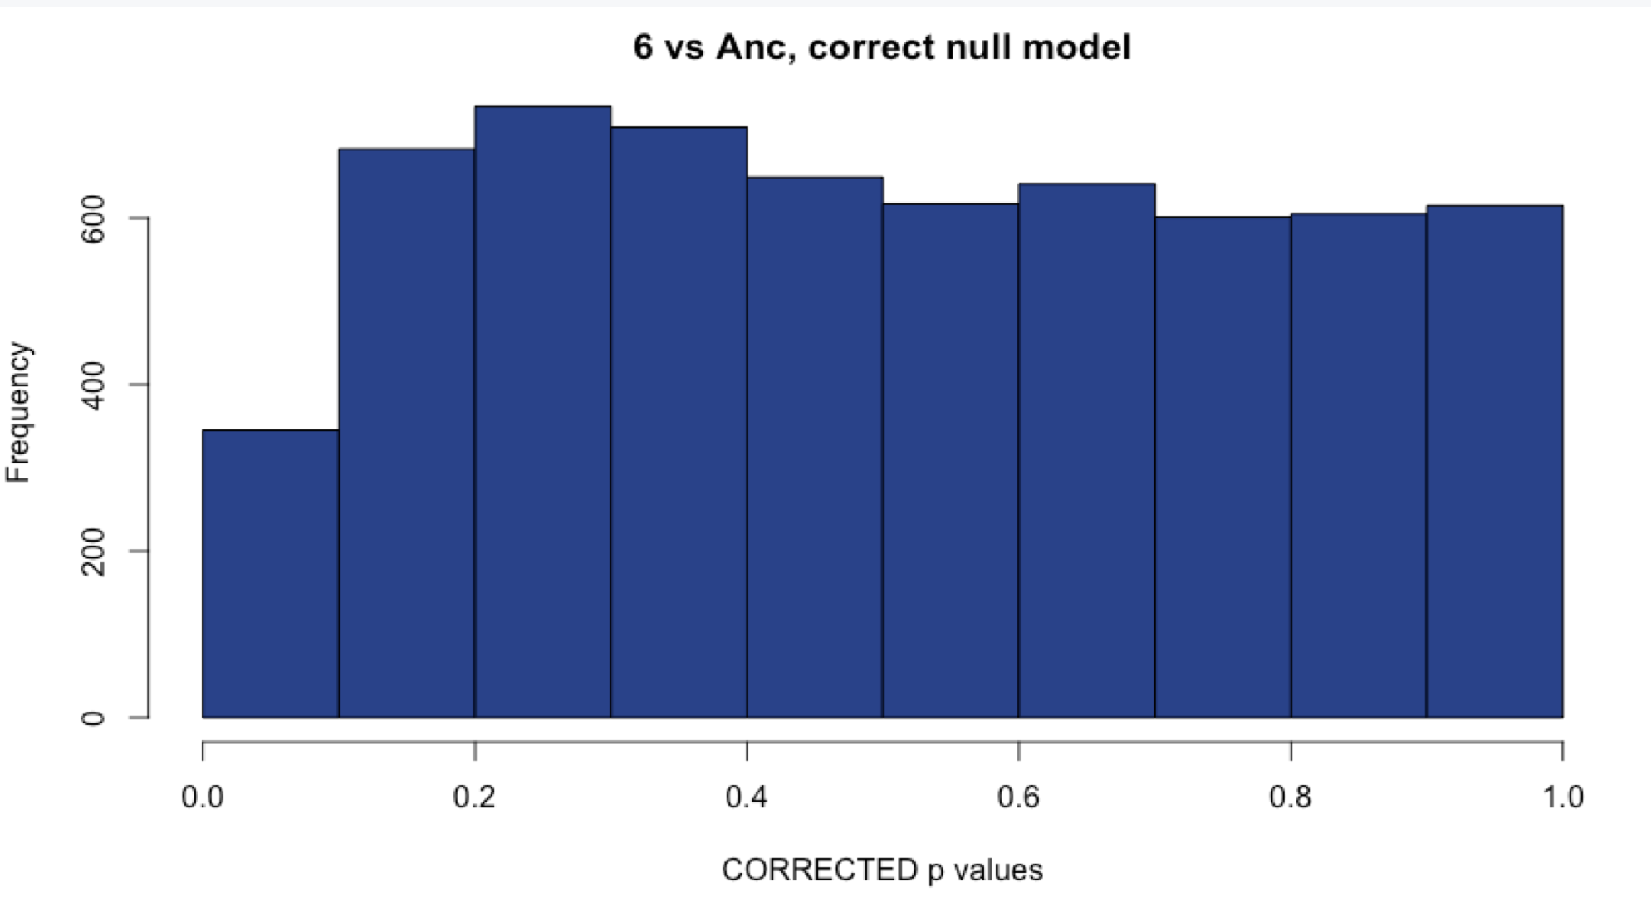
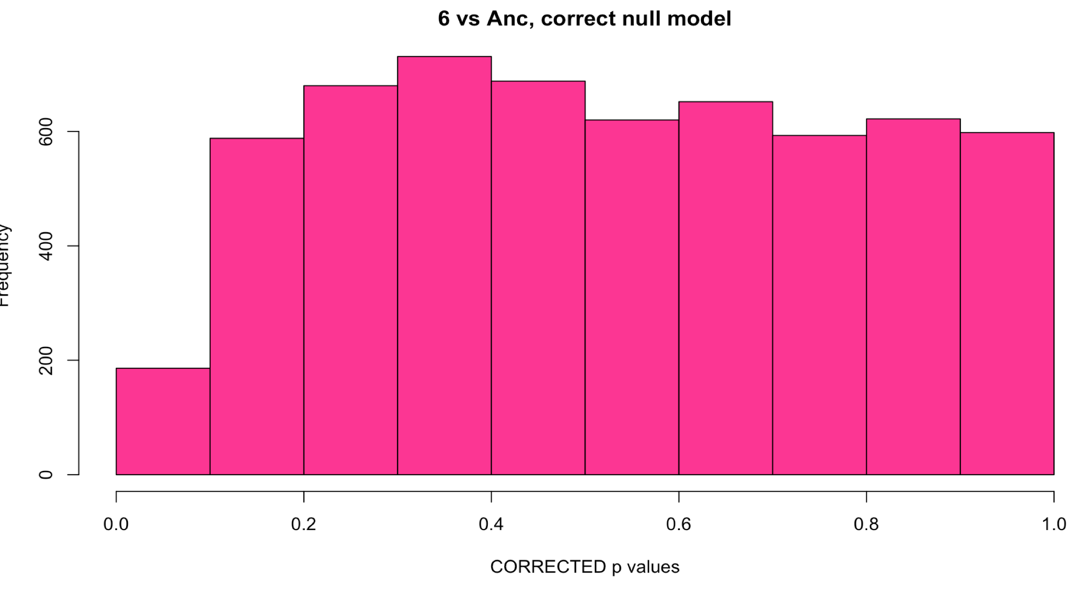
Sample 6: Comparison with methods
WITH Aneuploid C’somes WITHOUT Aneuploid c’somes
# DE: ~2100
# DE: ~2100
Uncorrected
Corrected with fdrtool
# DE: 1
# DE: 0
Notes:
Unsure of what to do here.

Slide 15
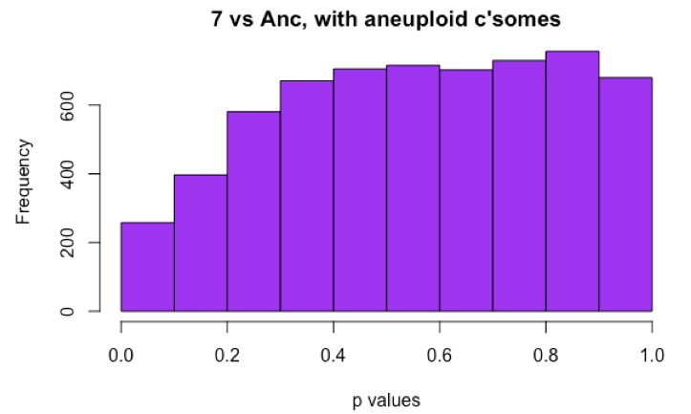
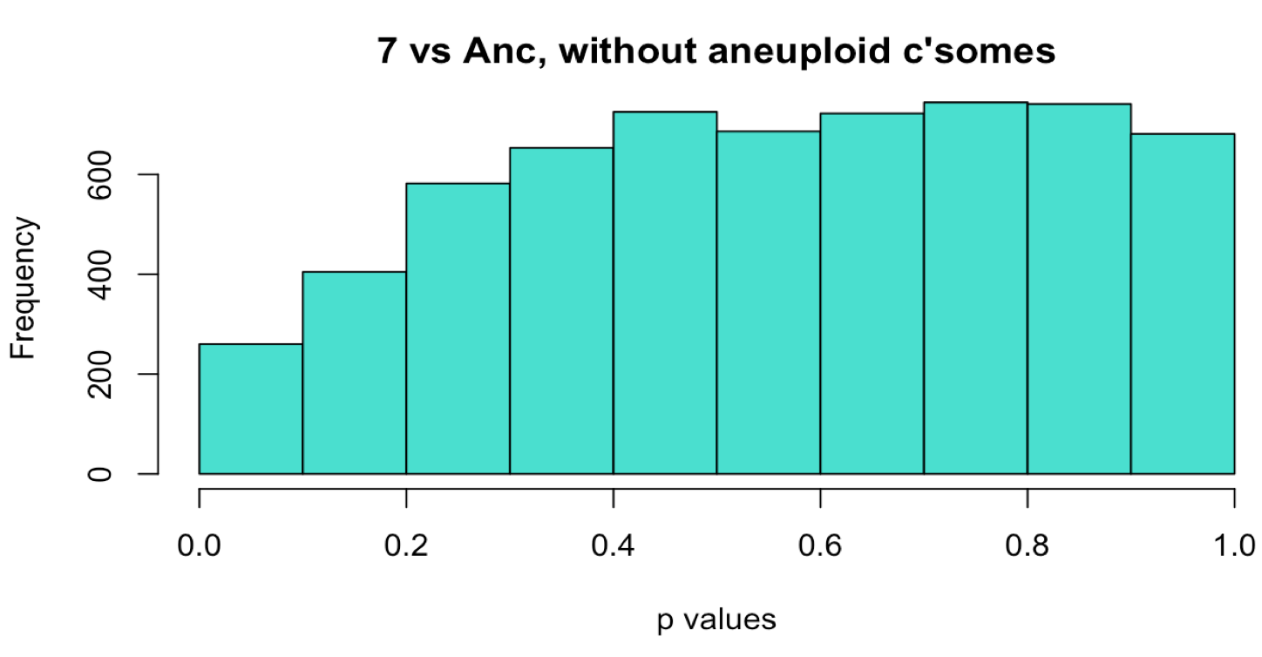
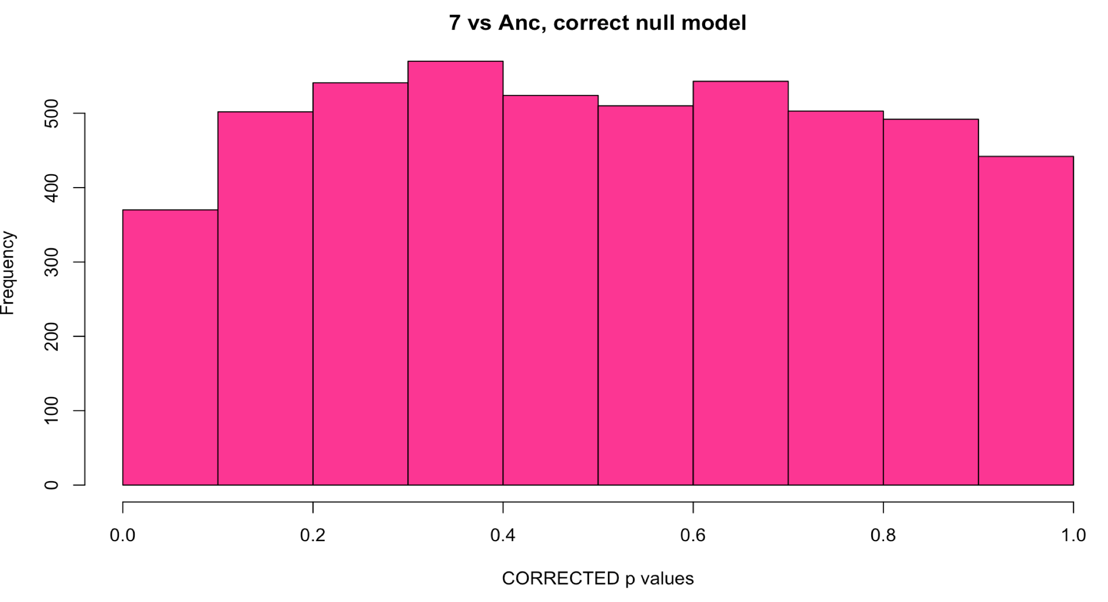
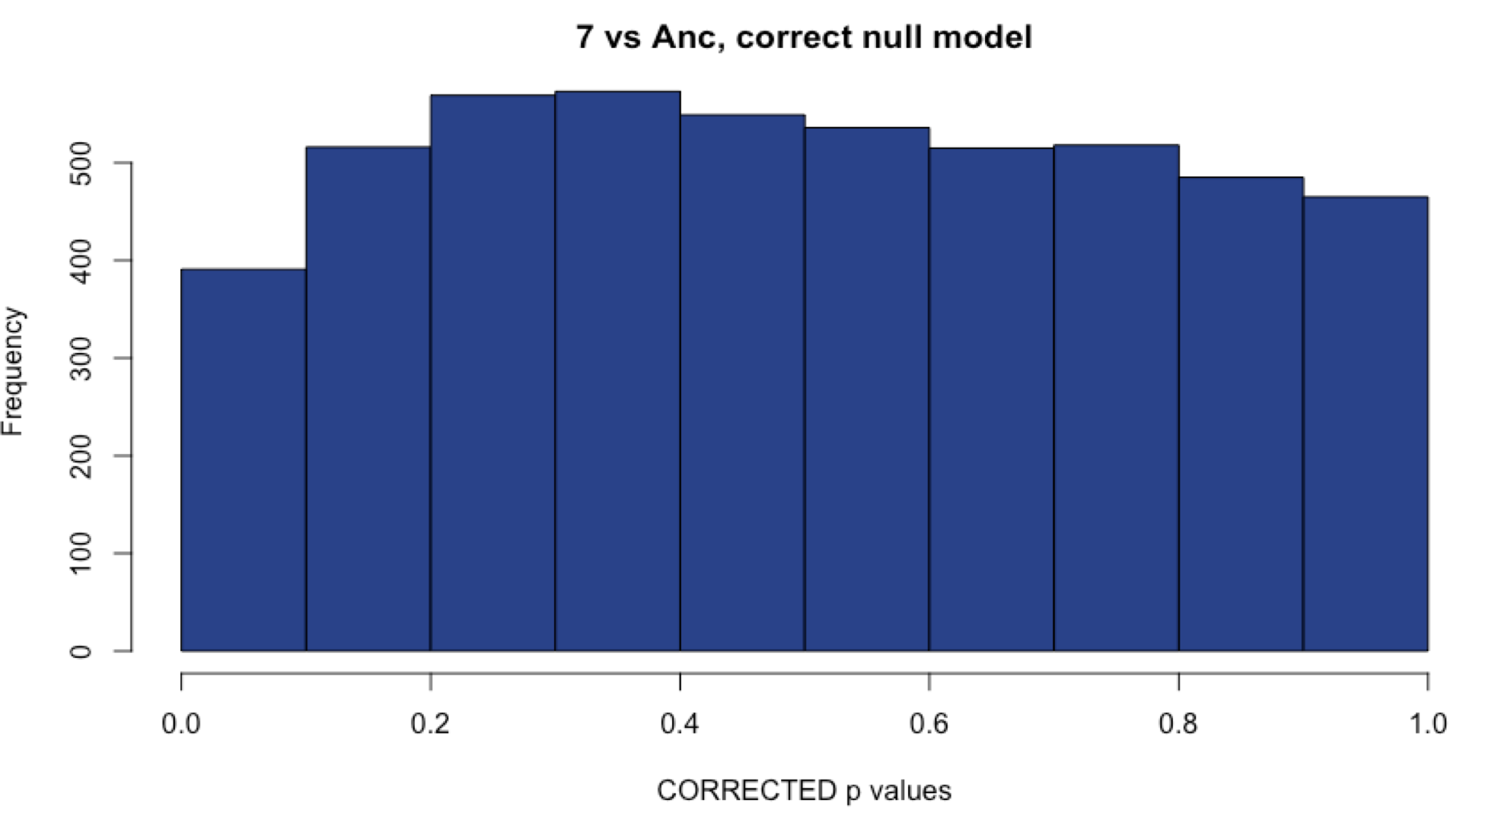
Sample 7: Comparison with methods
WITH Aneuploid C’somes WITHOUT Aneuploid c’somes
# DE: 17
# DE: 19
Uncorrected
Corrected with fdrtool
# DE: 26
# DE: 26
112vsAnc
Notes:
Choosing the corrected method since the original has a hill-shaped histogram, and this sample is aneuploid!

Slide 16
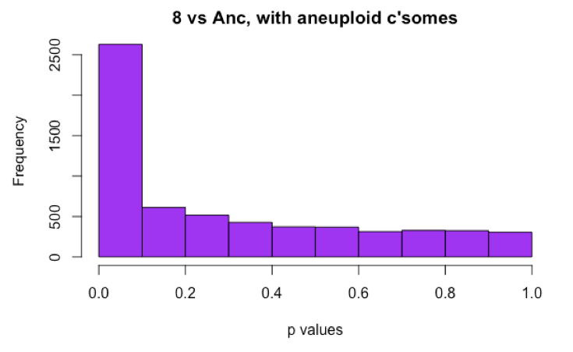

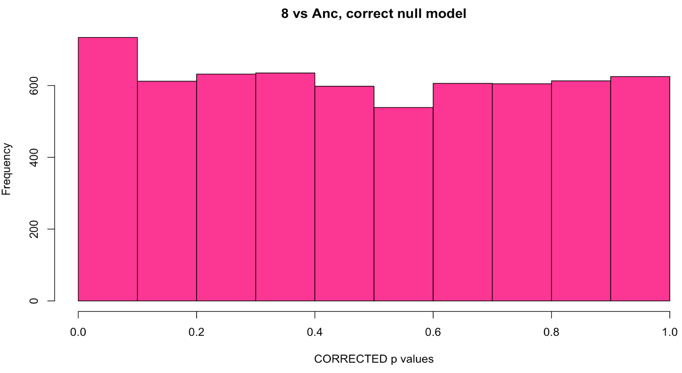
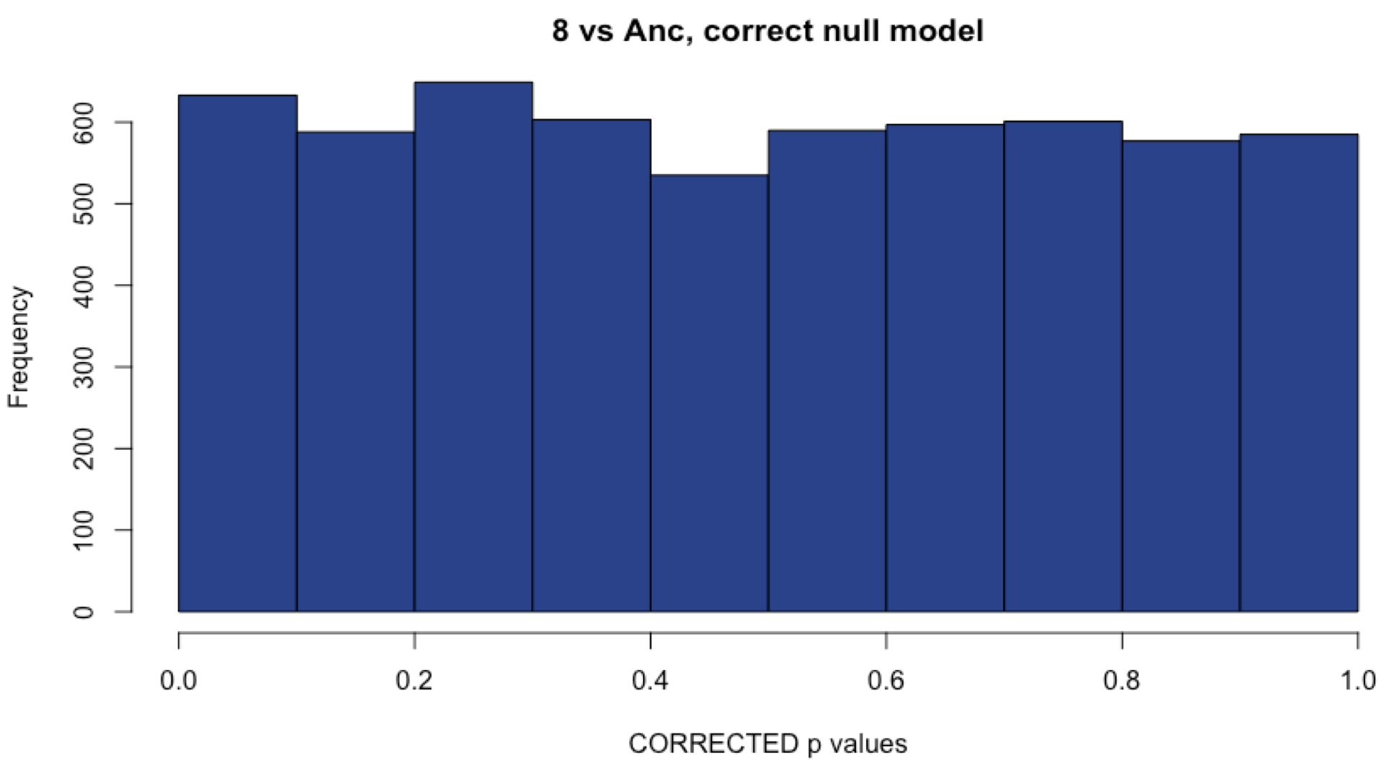
Sample 8: Comparison with methods
WITH Aneuploid C’somes WITHOUT Aneuploid c’somes
# DE: ~1850
# DE: ~1800
Uncorrected
Corrected with fdrtool
# DE: 60
# DE: 102
Notes:
Choosing the uncorrected method, since it gives me the most DE genes, and this line is aneuploid for two different chromosomes (expecting higher numbers of DE genes)

Slide 17
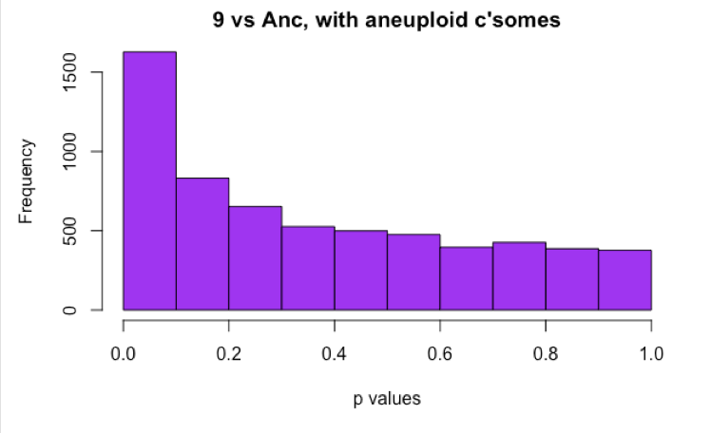
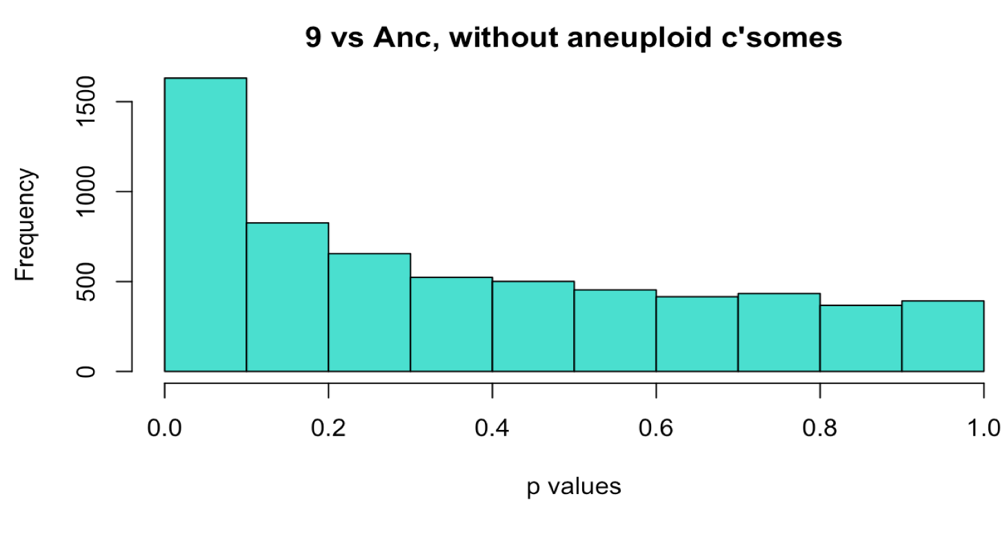
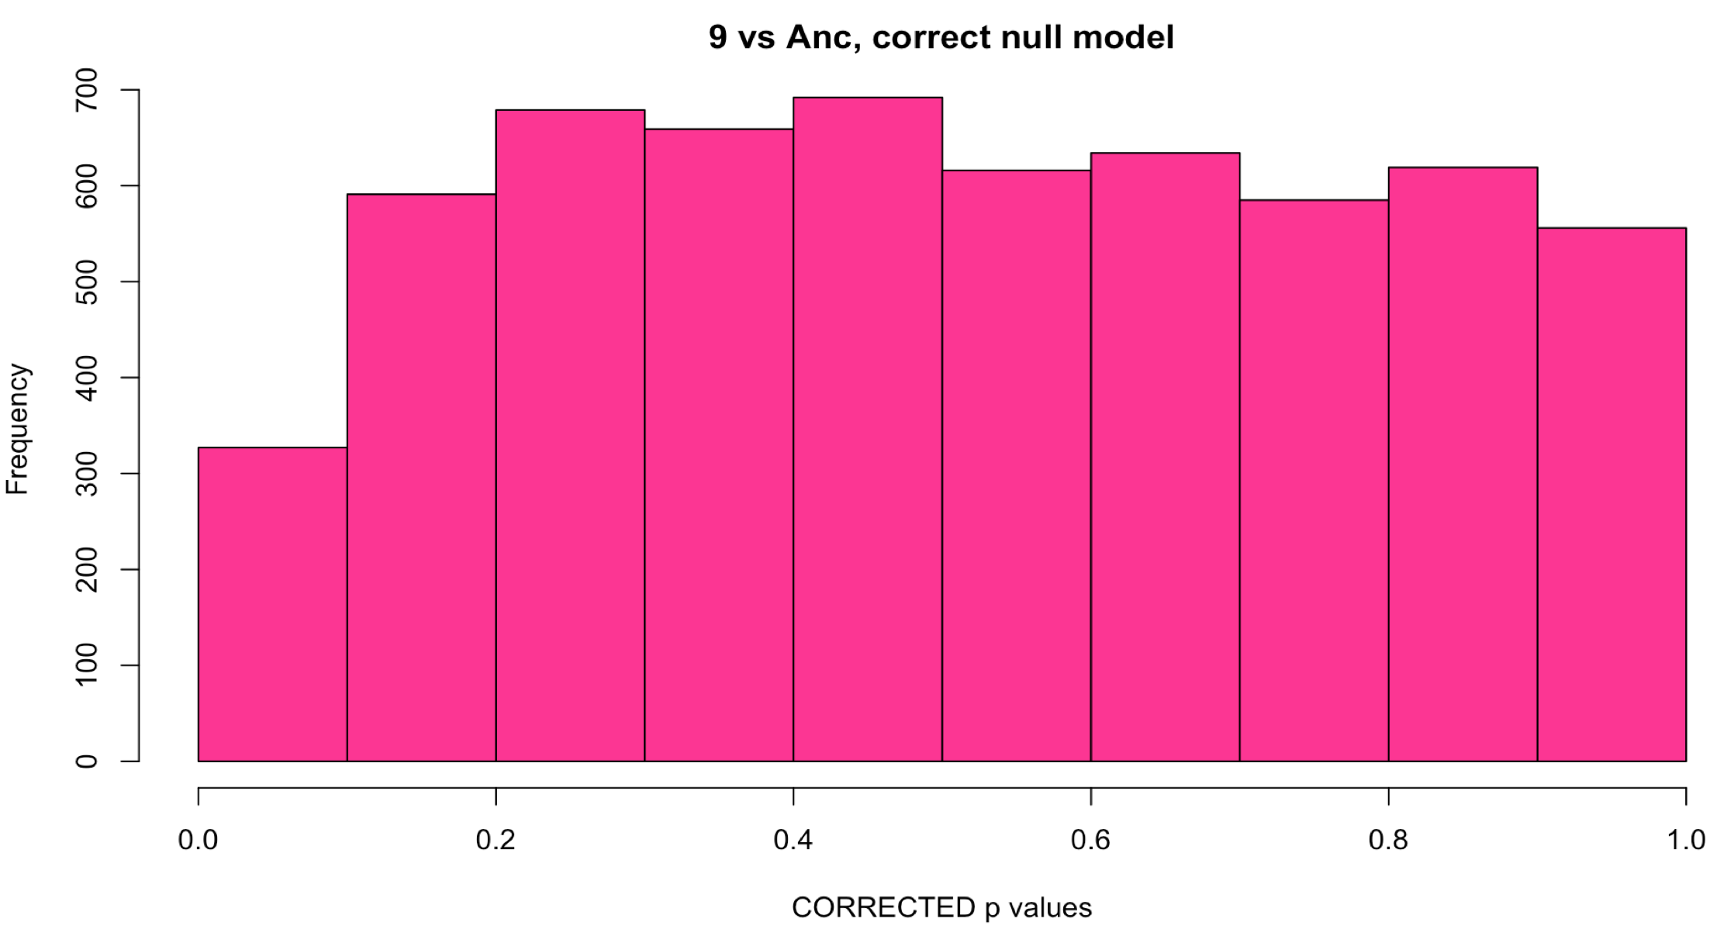
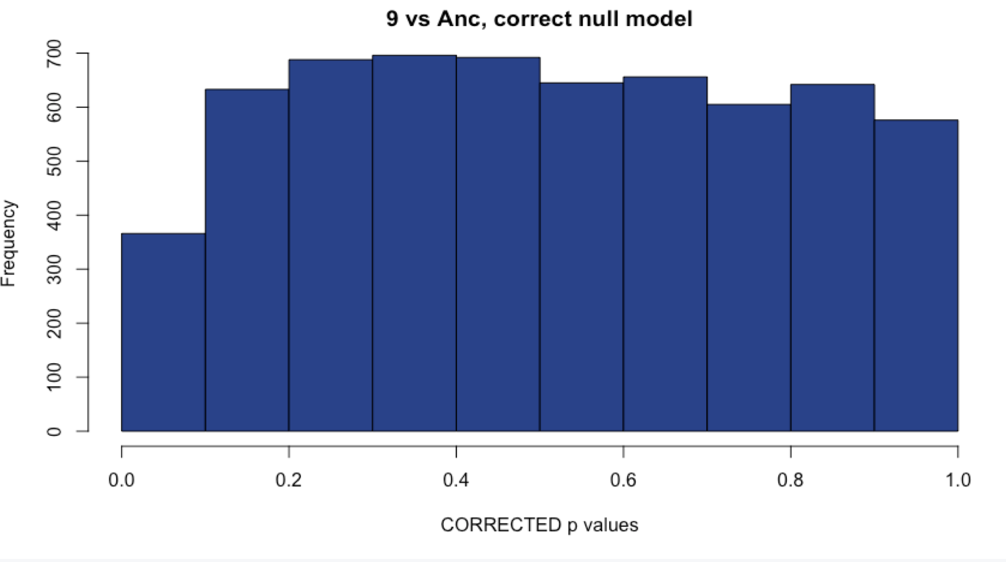
Sample 9: Comparison with methods
WITH Aneuploid C’somes WITHOUT Aneuploid c’somes
# DE: 113
# DE: 119
Uncorrected
Corrected with fdrtool
# DE: 4
# DE: 4
Notes:
Unsure of what to do here

Slide 18
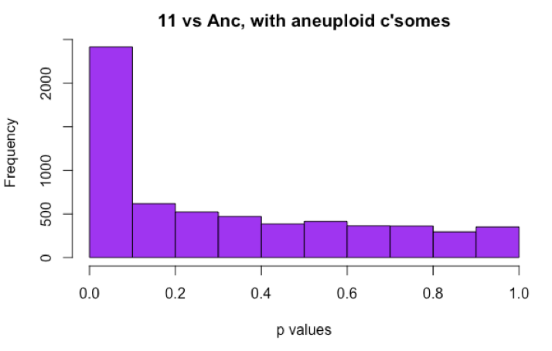
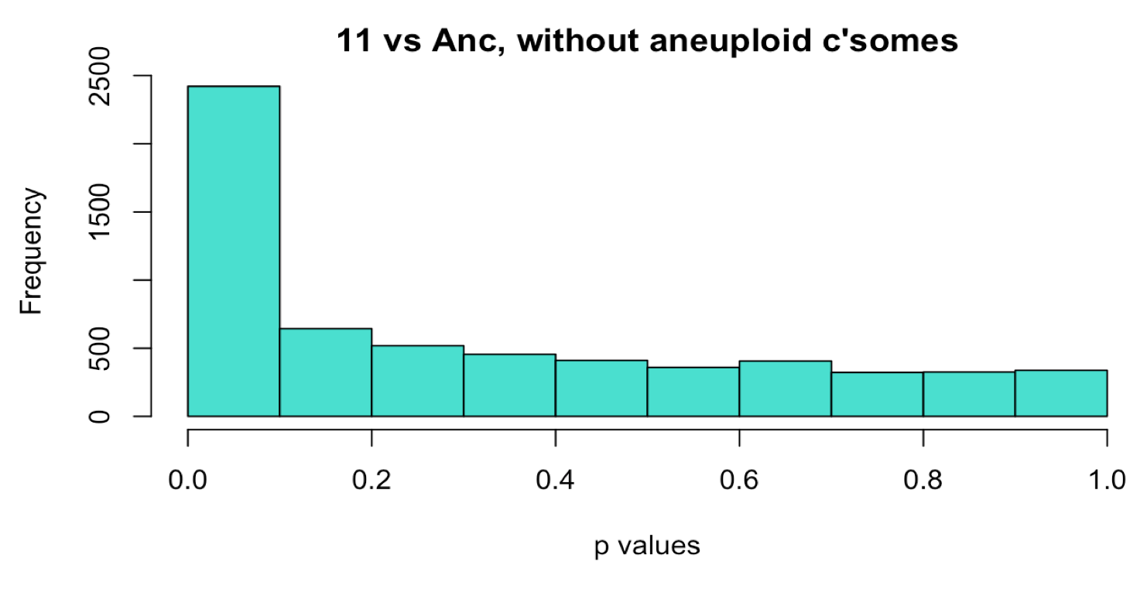
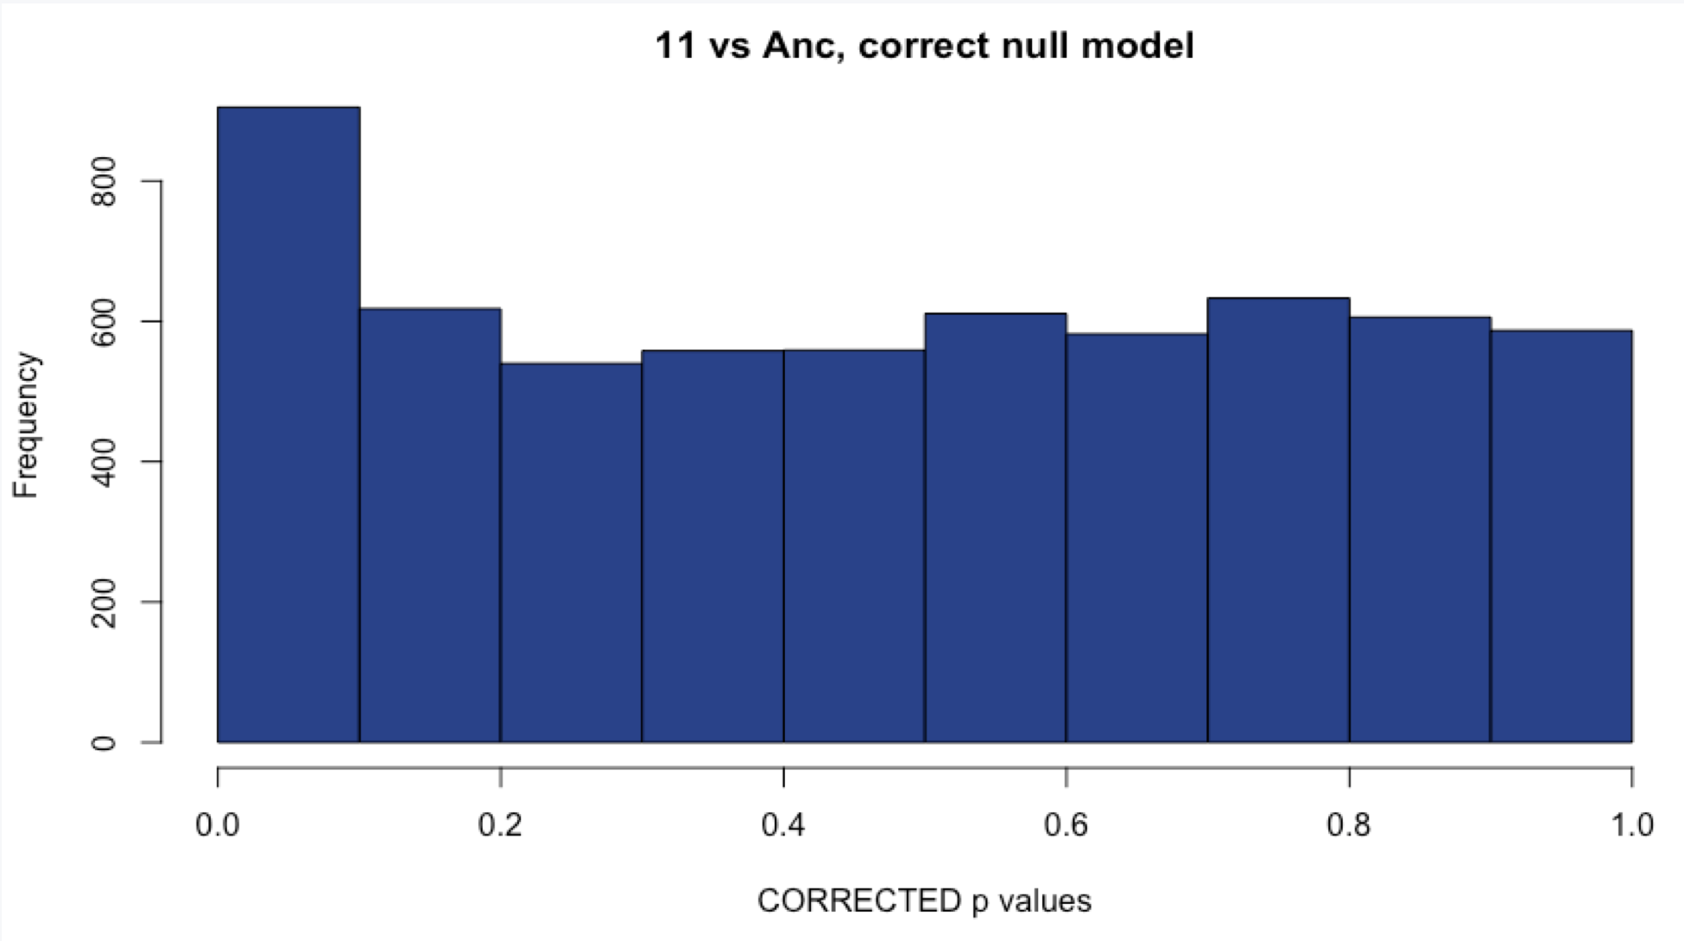
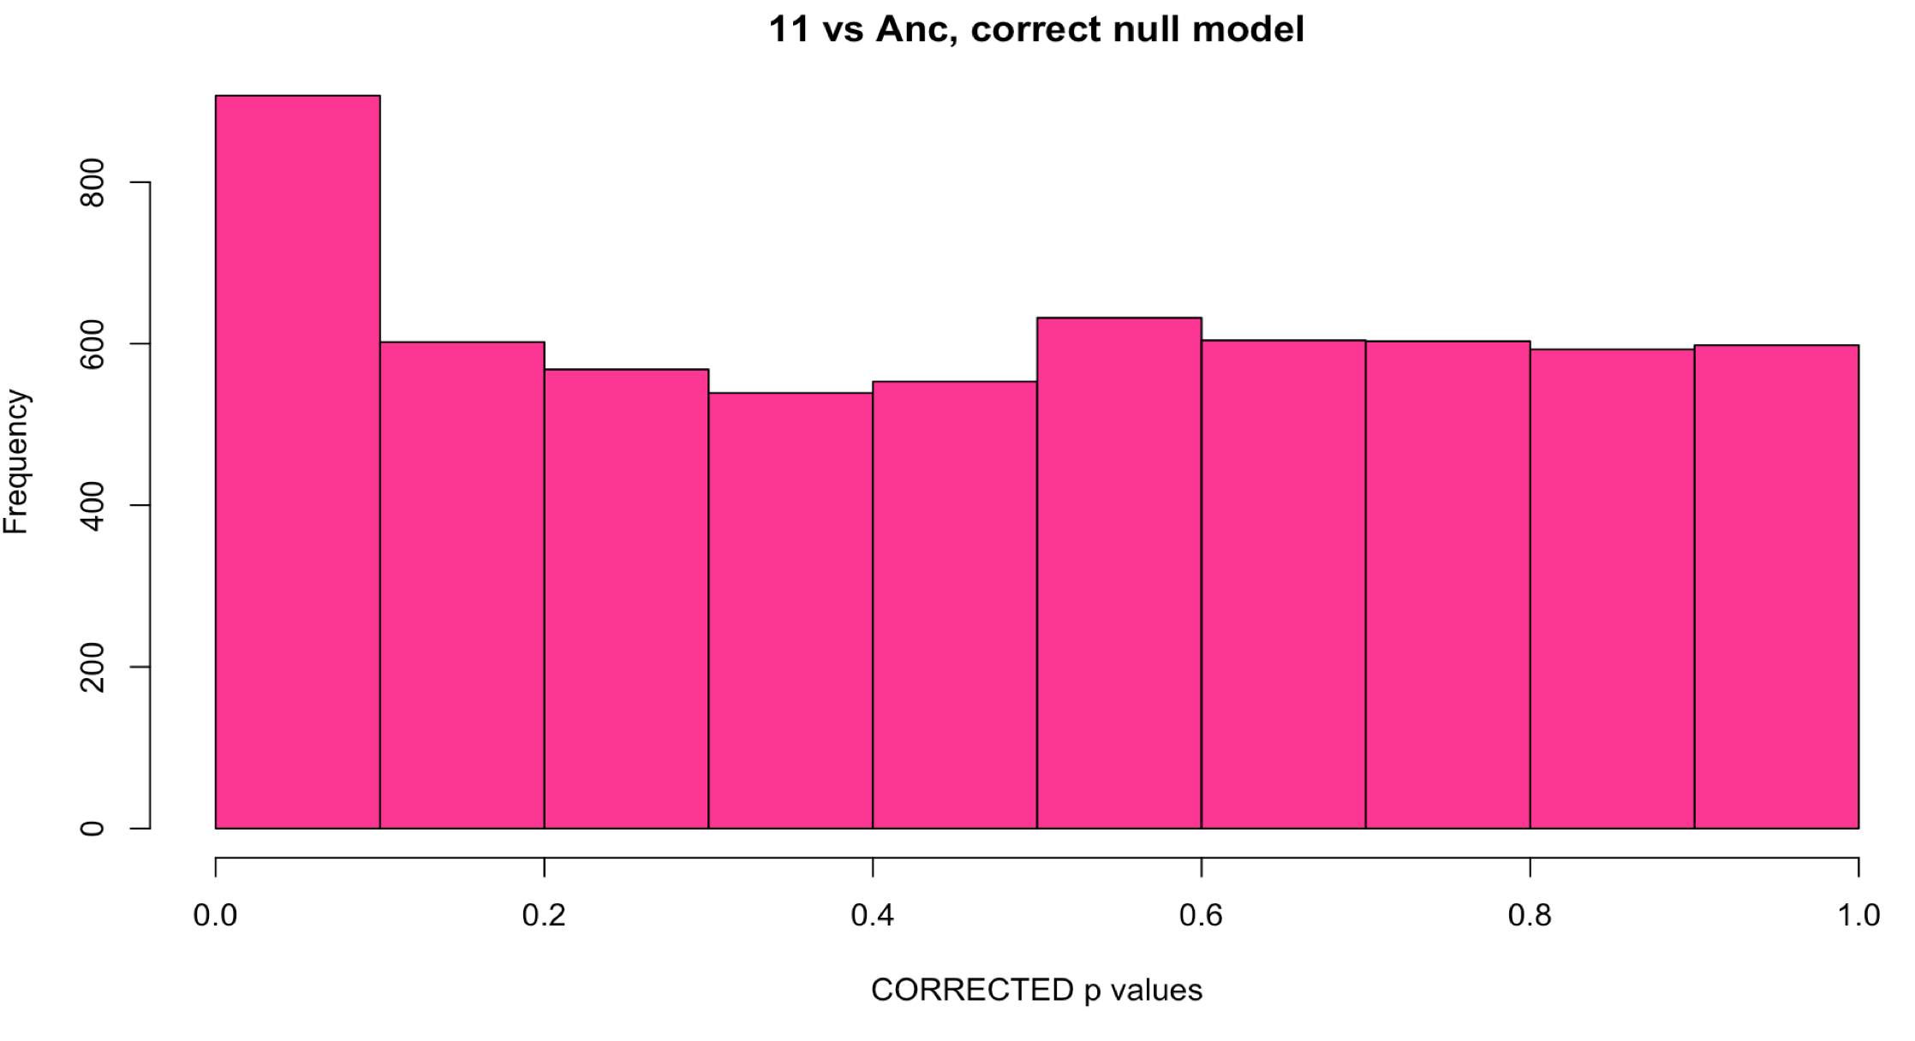
Sample 11: Comparison with methods
WITH Aneuploid C’somes WITHOUT Aneuploid c’somes
# DE: ~1600
# DE: ~1100
Uncorrected
Corrected with fdrtool
# DE: 109
# DE: 108
Notes:
Choosing the uncorrected method, like 18, this sample has two aneuploid chromosomes and I would expect a large number of DE genes.

Slide 19
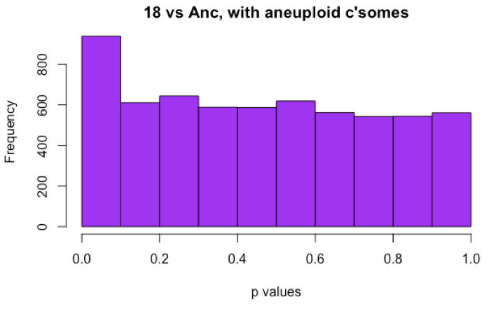
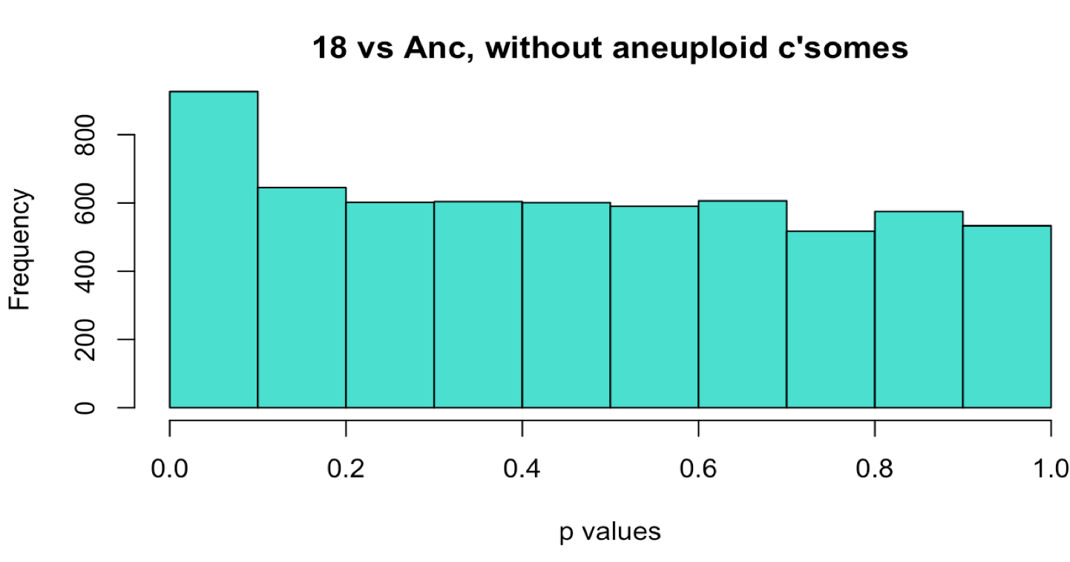
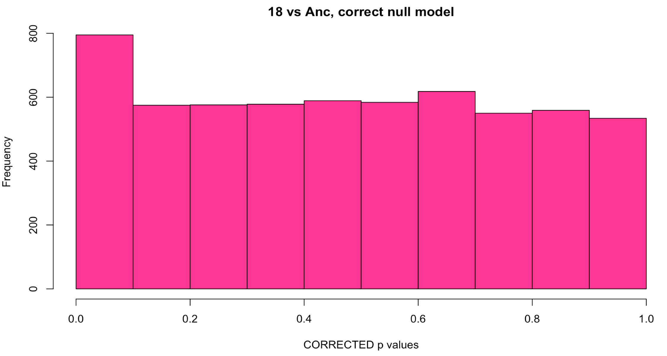
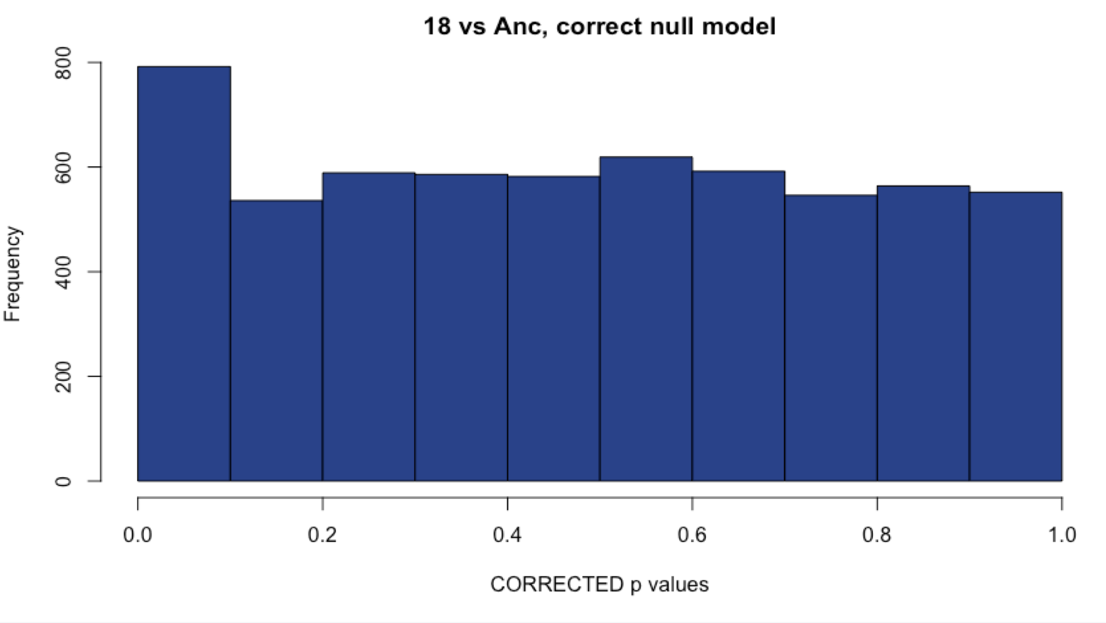
Sample 18: Comparison with methods
WITH Aneuploid C’somes WITHOUT Aneuploid c’somes
# DE: ~200
# DE: 225
Uncorrected
Corrected with fdrtool
# DE: 115
# DE: 155
Notes:
Choosing the uncorrected method, as it is behaving properly and has a large number of DE genes.

Slide 20
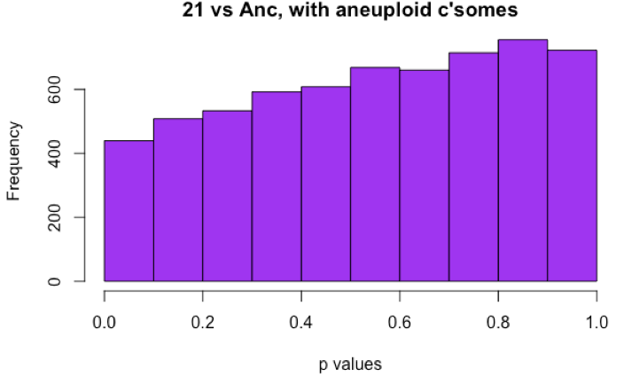
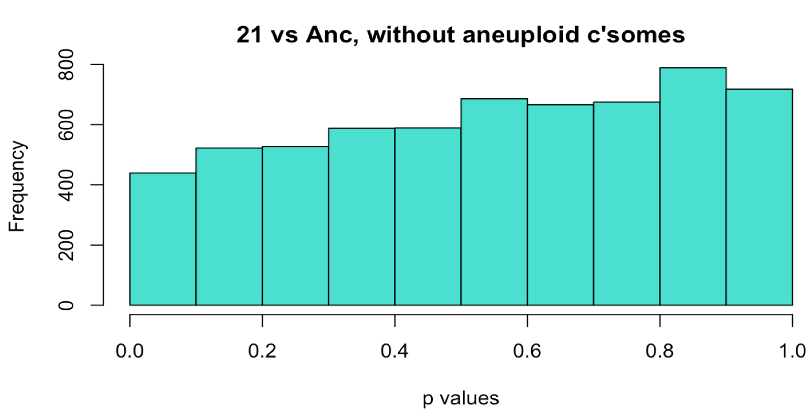
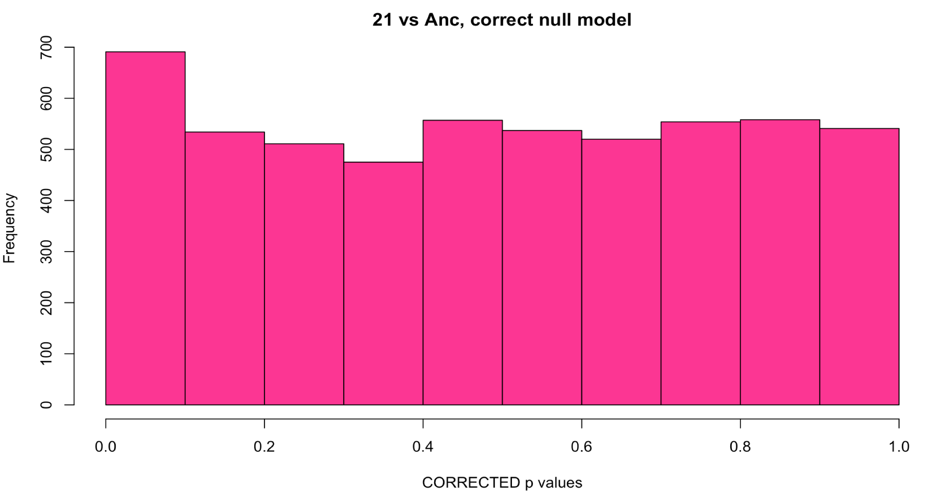
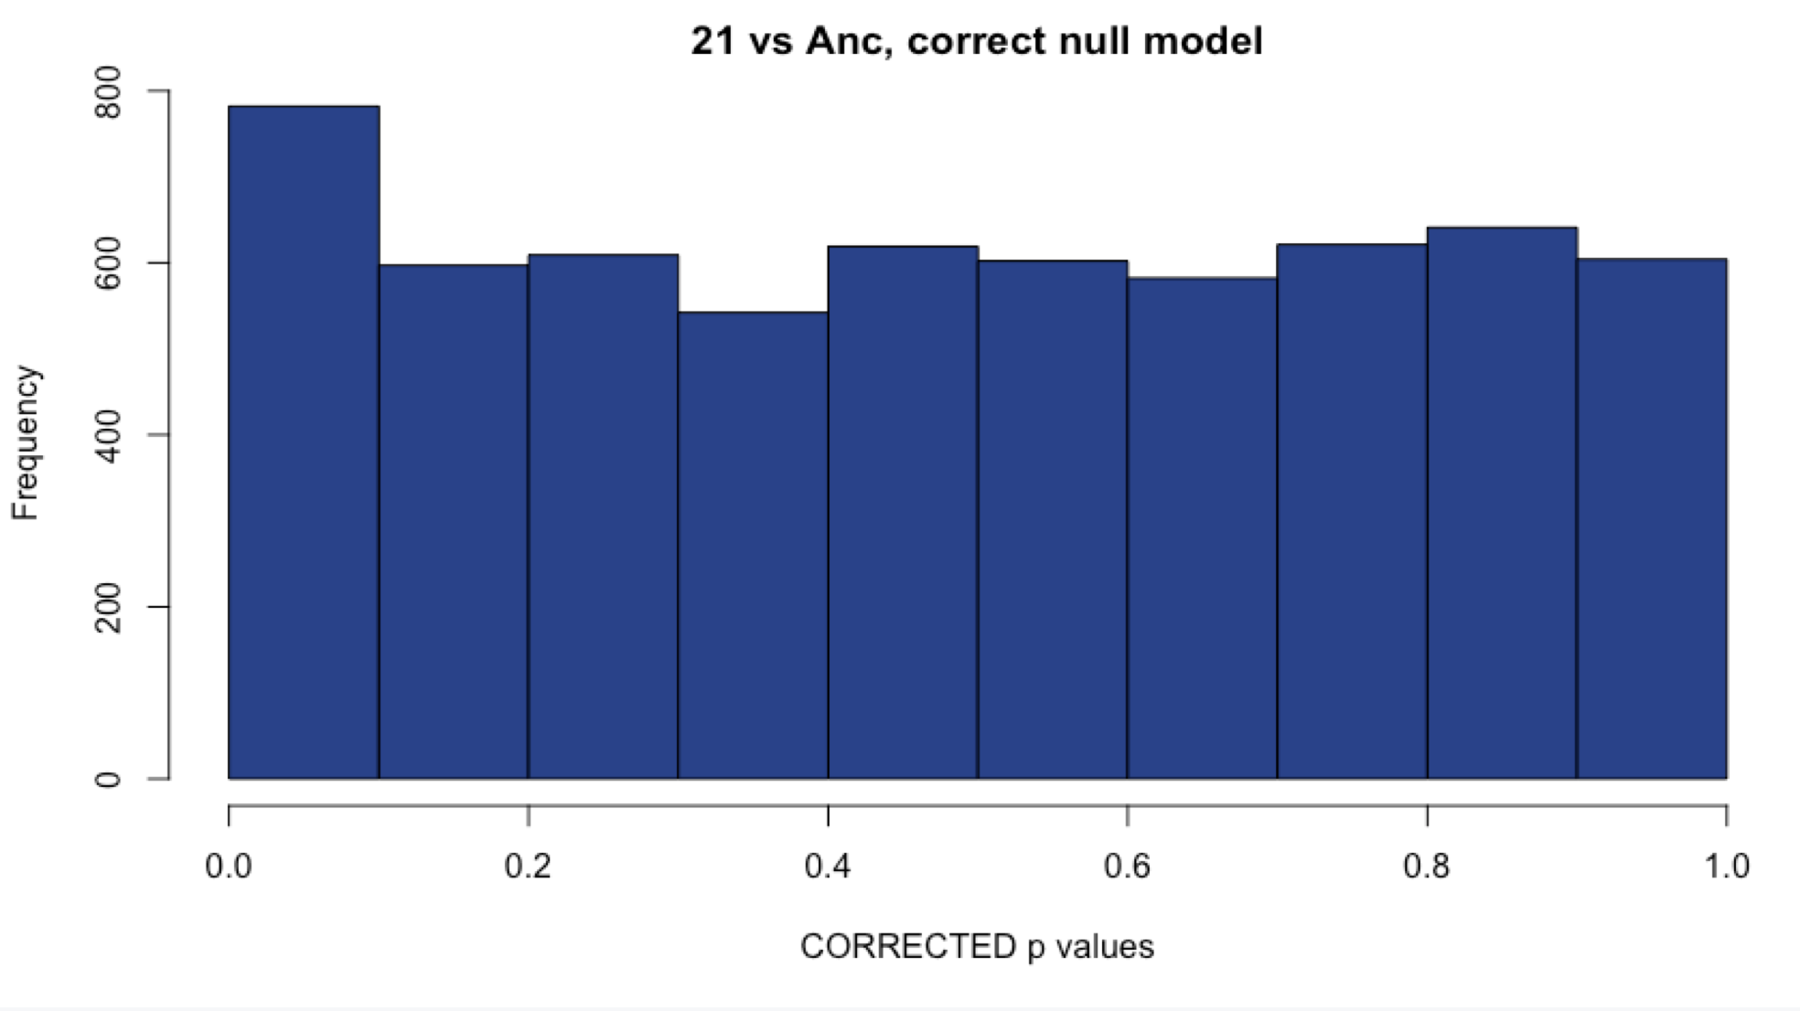
Sample 21: Comparison with methods
WITH Aneuploid C’somes WITHOUT Aneuploid c’somes
# DE: 6
# DE: 13
Uncorrected
Corrected with fdrtool
# DE: 34
# DE: 37
Notes:
Choosing the corrected method, since the histogram before correction hints at a hill-shape and the corrected method gives me more DE genes.

Slide 21
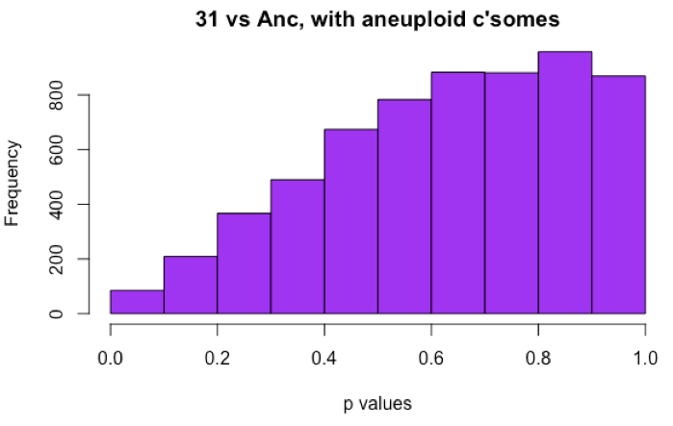



Sample 31: Comparison with methods
WITH Aneuploid C’somes WITHOUT Aneuploid c’somes
# DE: 0
# DE: 0
Uncorrected
Corrected with fdrtool
# DE: 5
# DE: 5
Notes:
Choosing the corrected method, since the original histogram is hill-shaped, and the corrected version gives me 5 DE genes, > 0!

Slide 22




Sample 49: Comparison with methods
WITH Aneuploid C’somes WITHOUT Aneuploid c’somes
# DE: 107
# DE: 109
Uncorrected
Corrected with fdrtool
# DE: 67
# DE: 81
Notes:
Choosing the uncorrected, as the histogram looks fine, and this sample is aneuploid so I expect a lot of DE genes.

Slide 23




Sample 59: Comparison with methods
WITH Aneuploid C’somes WITHOUT Aneuploid c’somes
# DE: 220
# DE: 262
Uncorrected
Corrected with fdrtool
# DE: 129
# DE:194
Notes:
Choosing uncorrected, histogram is fine, aneuploid sample, lots of DE genes

Slide 24




Sample 61: Comparison with methods
WITH Aneuploid C’somes WITHOUT Aneuploid c’somes
# DE: 193
# DE: 221
Uncorrected
Corrected with fdrtool
# DE: 214
# DE: 248
Notes:
Unsure of which to choose here. Aneuploid sample. Both histograms look similar. Just go with corrected to get the most DE genes?

Slide 25




Sample 66: Comparison with methods
WITH Aneuploid C’somes WITHOUT Aneuploid c’somes
# DE: 0
# DE: 2
Uncorrected
Corrected with fdrtool
# DE: 15
# DE: 15
Notes:
Corrected – fixes the hill-shaped histogram and gives us some DE genes

Slide 26




Sample 69: Comparison with methods
WITH Aneuploid C’somes WITHOUT Aneuploid c’somes
# DE: 2
# DE: 2
Uncorrected
Corrected with fdrtool
# DE: 12
# DE: 15
Notes:
Corrected: fixes hill-shaped histogram and gives us DE genes

Slide 27




Sample 76: Comparison with methods
WITH Aneuploid C’somes WITHOUT Aneuploid c’somes
# DE: 250
# DE: 331
Uncorrected
Corrected with fdrtool
# DE: 207
# DE: 252
Notes:
Uncorrected: histogram looks fine, aneuploid sample

Slide 28




Sample 77: Comparison with methods
WITH Aneuploid C’somes WITHOUT Aneuploid c’somes
# DE: 300
# DE: ~300
Uncorrected
Corrected with fdrtool
# DE: 20
# DE: 20
Notes:
Uncorrected, histogram looks fine, aneuploid sample.

